Slide 1
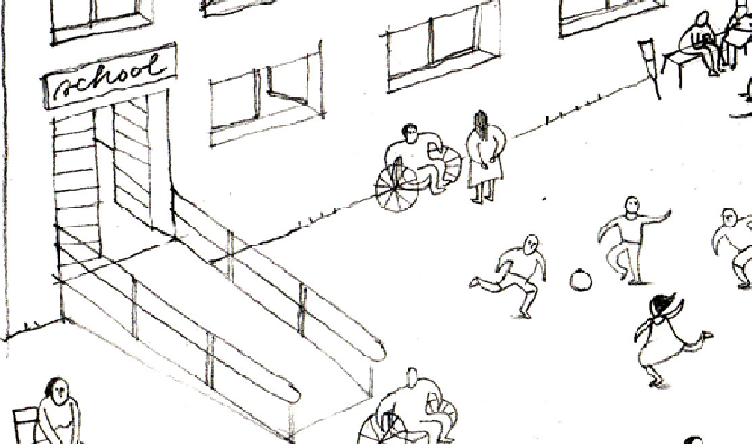

Inclusion of Persons with Disabilities in Shelter and Settlements Programming
Global Shelter Cluster
ShelterCluster.org
Coordinating Humanitarian Shelter
GSC Meeting Session: 20 October 2020
Notes:
Introductions of group

Slide 2
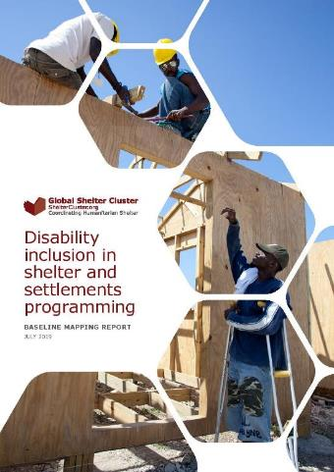
Agenda
Overview of working group & update on current activities
Presentation + discussion: Inclusion of persons with disabilities in shelter and settlements programming – thinking beyond physical access
Presentation + discussion: Inclusion of persons with disabilities in decision making
Discussion of questions raised in survey
Next steps and ongoing support to field staff
Notes:
Brief overview of agenda
Ask for any other business to put at end

Slide 3
Working group on Inclusion of Persons with Disabilities
Aim:
Build on existing guidelines and work around vulnerability, to integrate a wider and more systematic disability inclusive approach to shelter and settlements programming.
How:
Understand the reality of disability inclusion in shelter and settlements programming (establish baseline) to identify areas of support and/ or investigation
Act as a forum to bring other organisations, sectors and actors together to share good practices for inclusion of persons with disabilities in programming and response.
Test and review the efficacy of All Under One Roof (AUOR) and other inclusive guidance in practice with a view to identifying practical support tools
Disseminate GSC tools and Standards for use by cluster members, organisations of persons with disabilities and relevant actors.
Develop plans for inclusive shelter support in emergency operations.
Notes:
Brief overview of agenda
Ask for any other business to put at end

Slide 4
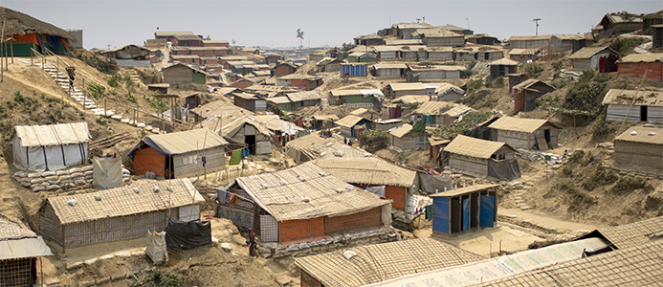
Inclusion of Persons with Disabilities in Shelter and Settlements Programming – Field Consultancy: Cox’s Bazar
Global Shelter Cluster
ShelterCluster.org
Coordinating Humanitarian Shelter
Notes:
David to give a brief 2 min update

Slide 5
Inclusion of persons with disabilities in shelter and settlements programming – thinking beyond physical access
Persons with disabilities include those who have long term physical, mental, intellectual or sensory impairments which in interaction with various barriers may hinder their full and effective participation in society on an equal basis with others. (UNCRPD 2006)
Baseline mapping highlighted:
tools and guidance focus on issues of physical mobility or sensory impairment rather than a broader understanding of disability
shelter and settlement actors are most familiar with physical or environmental barriers and less with communication and attitudinal barriers (having implications for persons with intellectual, sensory and psychosocial disabilities and women and girls with disabilities who may face intersecting forms of discrimination).

Slide 6
Inclusion beyond physical access: intersections between Shelter, Health and Disability Inclusion
Shelter and Health Learning Day
  Inadequate shelter and physical health.
  Inadequate shelter and mental health
Gaps in knowledge...next steps
Disability Inclusion Working Group
GSC Update
20th October 2020

Slide 7
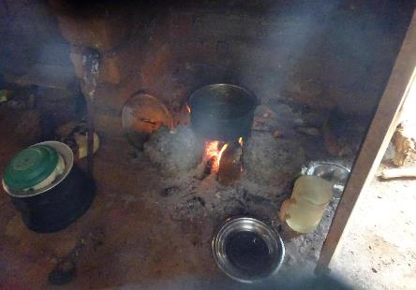
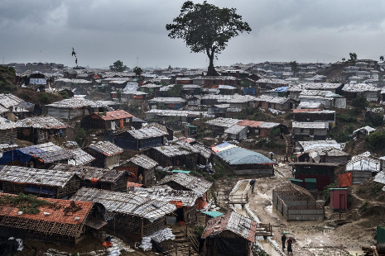
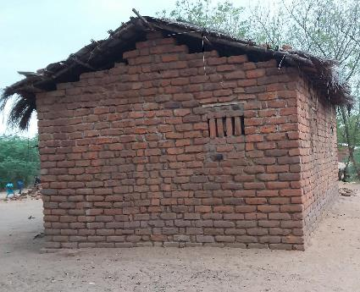
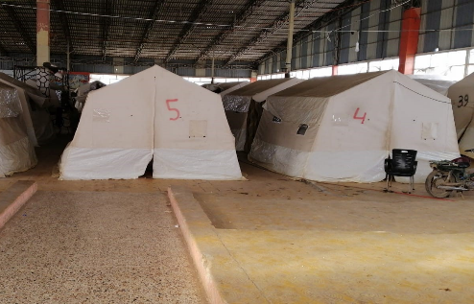
Notes:
There are so many ways that housing and indeed humanitarian shelter affect people’s health. Here are just some examples:
• Poor ventilation...and use of wood and charcoal for cooking indoors are clearly causes of poor indoor air quality, high rates of respiratory infections like pneumonia. Also spread of COVID
• Dirty water, inadequate sanitation facilities cause diarrhoeal and other infections
• Other issues such as damp, poor mud floors, lack of protection from vectors of disease such as rats and mosquitoes are more examples.SOme issues very context specific, such as Malaria which is concentrated in Sub-Saharan Africa
• Overcrowding, noise and extreme temperatures are linked to stress, lack of sleep which contribute to cardiovascular disease….
Many of these links between inadequate housing and physical health are pretty obvious, yet are still poorly understood, even in the Global North. And implications of this incomplete knowledge for shelter programming only just being explored. We don’t know how shelter improvements lead to health improvements. Nor what co-benefits this might bring, for example better school attendance. Knowledge about inadequate shelter and mental health are even less well understood.

Slide 8
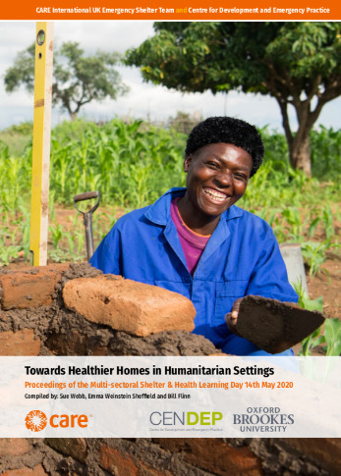
Shelter and Health Multi-sectoral Learning Day 14th May 2020
Learning Day in brief
20 presentations: links between housing and health...and humanitarian shelter
Representatives from Health, WaSH, Shelter
Recommendations and research gaps
Inter-cluster / inter-agency Environmental Health WG
Integrating health into assessments, implementation, evaluations ….
Generating evidence on impacts
Collaboration with development and health actors
Notes:
We organised the Shelter and Health multi-sectoral Learning Day in May in order to find out more. I know many of you attended, so I won’t dwell on it. The key idea was that the day involved both development and humanitarian actors. Both academics and practitioners. People with Shelter, Health and WaSH expertise….in other words, groups that don’t normally meet!
There were 20 presentations with opportunities for further discussion in breakout groups. Not enough time for discussion, but happily there have been many follow-up conversations and there are many more to come. One important point to make though is that we are aware that one group was missing from the conversation, as so often, the affected populations – the ‘home-makers’ themselves. Implication for DI, as for all shelter programming. How do we find out about affected populations’ priorities and plans? I know a subject for further exploration later this morning.
You can read the detail in the report. Link to the report here https://insights.careinternational.org.uk/publications/towards-healthier-homes-in-humanitarian-settings We want to draw your attention to the recommendations and discuss their relevance to disability inclusion in particular.
Inter-cluster / inter-agency Environmental Health WG...how might a wider EH lens in shelter programming make sure it includes those with different disabilities?
Integrating health into assessments, implementation, evaluations …. For all.
Generating evidence on impacts...on all
Collaboration with development and health, WaSH actors - what can we learn from different sectors? WaSH experts at learning day shared ways they ‘tweak’ programmes to ensure inclusion (e.g. of women and girls, of those with physical access issues)

Slide 9
People living with some disabilities are possibly more home-based = higher risk of shelter related health conditions
Different types of disabilities
Measuring outcomes of improved shelter
Need for better evidence
Mental health - key area of interest
Key Learning Day ‘takeaways’ relevant to Disability Inclusion
Notes:
Of course there are so many different types of disabilities – the focus is often on physical and visible disabilities e.g. mobility issues of the elderly. We don’t know much about greater impacts of inadequate shelter on people with varied disabilities. People with physical disabilities + other conditions spend more time in the home. So more exposed to poor air quality, damp, cold/excess heat… (Especially physical disabilities - we don’t know?)
Protection issues in humanitarian emergencies – for example, unsafe shelter – may disproportionately affect people with psychosocial disabilities.”
Do people have evidence of this? How can it be mitigated?
Housing improvements that address these issues could be beneficial to disadvantaged groups in multiple ways. As so often seems to the case, a barrier to improved programming is a lack of good quality evidence of the impacts of interventions (or the lack of them).
Do we have evidence of outcomes of shelter improvements on health? InterAction’s ‘Wider Impacts’ publication, authored by Fiona Kelling earlier this year, which emphasised the current lack of good quality evidence of the impacts of S&S assistance on health.
https://www.interaction.org/wp-content/uploads/2020/03/1.-Wider-Impacts-of-Shelter-Key-Findings_Final1.pdf
Fiona spoke also at the Learning Day a summary of her presentation is also in the Report. She spoke about data and the need for humanitarian Shelter practitioners to be very clear about what data they need, why they need it and how they are going to get and use it.
How could be set about measuring outcomes of ‘healthier home’ improvements for different groups of people? Are current M&E metrics able to capture that sort of information?
Links between mental health conditions and inadequate housing are even less well understood than the physical ...we’ll move on to that

Slide 10
Impact of trauma/displacement on existing MH conditions
Does the impact of trauma/displacement cause new MH conditions?
Can humanitarian responses cause/exacerbate MH conditions?
Unanswered questions
Interaction of shelter programming and mental health
Notes:
Mental health issues are less visible and have often been ignored/excluded – often due to simple ignorance of the issues.
Mental Health and Psychosocial Support – this topic was addressed during one of the panels on the Learning Day. Topics such as tenure security and how it affects mental health were addressed. Again, you can read the summaries of the presentations in the Report.
“...people with mental health conditions are more likely to be in vulnerable situations that worsen the social, emotional, physical and economic impacts of the pandemic, and all too often are “left behind” in emergency response as well as ongoing development efforts.”
There are perhaps 3 main areas of interest for programming to be aware of:
What impact trauma/displacement have on existing MH conditions
The question of how trauma/displacement cause new MH conditions -and for how long might these persist?
· Also the question of whether humanitarian responses can cause or exacerbate MH conditions?
Specific examples of issues that can create mental ill-health include tenure insecurity, loss of livelihoods and the whole process of displacement itself. Although there is some anecdotal evidence that rebuilding can be therapeutic, these is a lack of solid evidence for this.
Again, there are many unanswered questions and knowledge gaps. As we learn more about the connections between shelter and health, what does that knowledge mean for Disability Inclusion?

Slide 11
Sue Webb
s.webb@brookes.ac.uk
Emma Weinstein Sheffield Weinstein-Sheffield@careinternational.org
https://self-recovery.org
Thank you

Slide 12
Inclusion of persons with disabilities in shelter and settlements programming: thinking beyond physical accessibility
ensure programs, assistance mechanisms and communications/ information are accessible for persons with different types of impairments
ensure shelter staff are aware of the various types of barriers that exist in accessing shelter and settlements programs and assistance (some could be pre-existing, others could be created by the emergency) and actions that can reduce these barriers
establish relevant referral mechanisms and linkages to enable necessary technical support from OPDs, local actors
Resources: IASC Guidelines for inclusion of Persons with Disabilities in Humanitarian Action, CBM Humanitarian Hands on Tool

Slide 13
Inclusion of persons with disabilities in decision making
The CRPD affirms the right to participate in decision-making processes. Persons with disabilities are therefore entitled to participate in humanitarian decisions that affect them. Both on the basis of this right, and because they have knowledge and skills to offer, persons with disabilities can be important actors and resource persons in a humanitarian response. IASC Guidelines on Inclusion of Persons with Disabilities in Humanitarian Action
Baseline mapping highlighted:
few examples from shelter and settlements practice on inclusion of persons with disabilities and their care givers in decision making
barriers to inclusion in decision making include attitudes of family and community members and not being linked to community decision making processes (particularly for women and girls with disabilities) + inaccessible information
2 relevant case studies: IOM South Sudan, Fiji Shelter Cluster

Slide 14
IOM South Sudan
Camp Coordination and Camp Management
Global Shelter Retreat Presentation
19 October 2020

Slide 15
“Users as Designers” Approach
End user should be hands-on alongside technical focal person at every stage of design and testing
CCCM applied this approach to:
Accessible Infrastructure in Formal Camp setting done in consultation with Persons with Disabilities Committees

Slide 16
Consultation Process:
Community Consultation to Identify Priority Areas
Organization of committee of persons with disabilities, inclusive of diverse conditions
Site visits, walk-arounds, and interviews in “problem areas”

Slide 17
Infrastructure Prototyping:
Interactive design sessions with PWD committee
Construction of infrastructure prototypes;
Trial installation period with testing by PWD committee;
Design changes and development of final design
Implementation:
Community selection of installation locations
Installation and handover to community
Follow-up and ongoing consultation

Slide 18
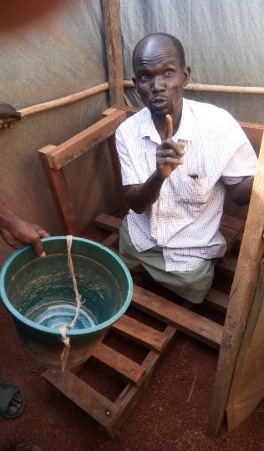
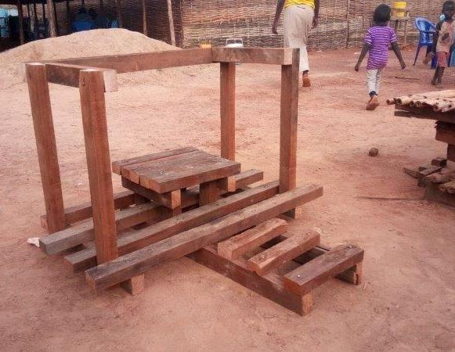
Accessible Showers/ Bathing

Slide 19
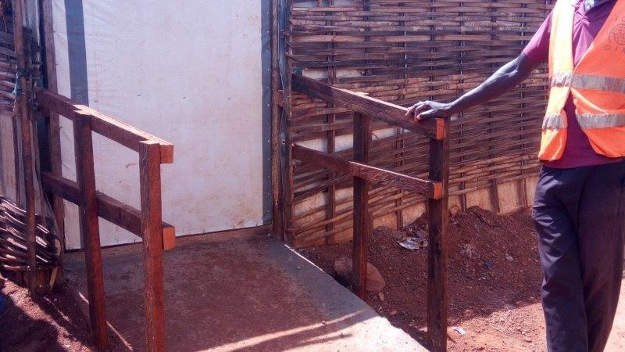
Entry Ramps

Slide 20
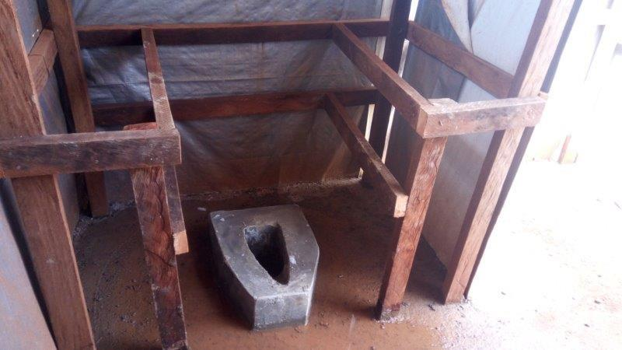
Accessible Latrine

Slide 21
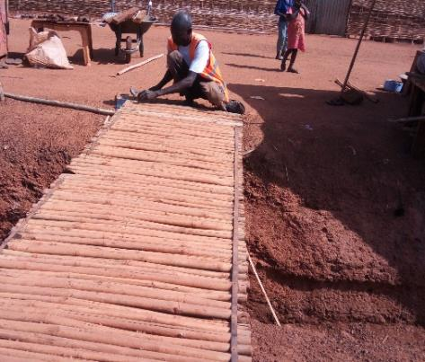
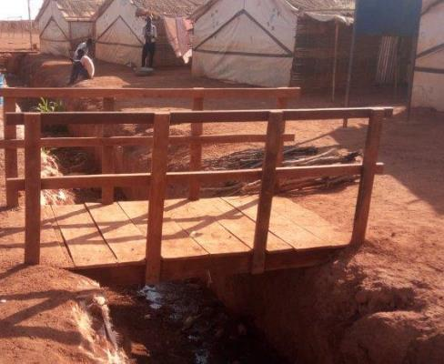
Footbridge Completed

Slide 22
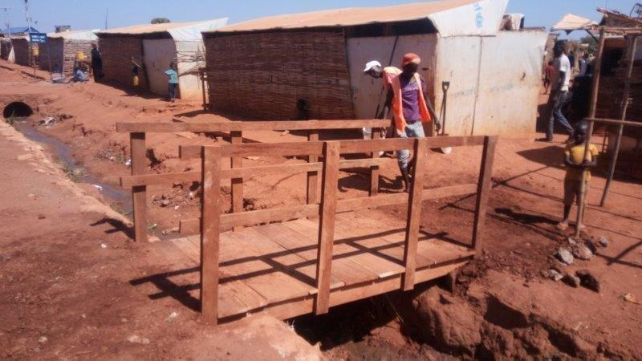
Easy to Access, Stable Crossing, Wheelchair

Slide 23
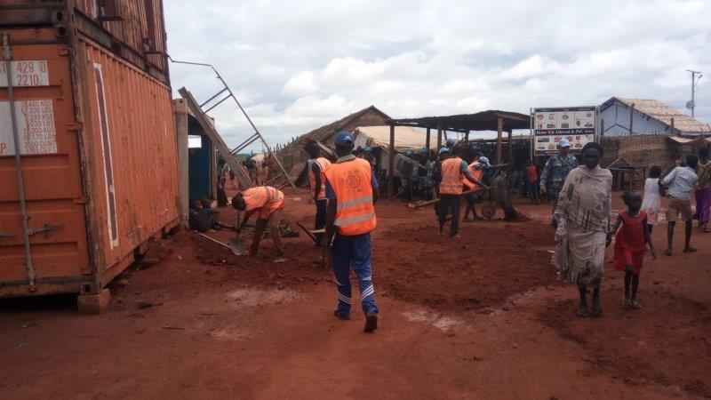
Easy to Access, Stable Crossing, Wheelchair
Pothole Filling: Mobility & Wheelchair Access

Slide 24
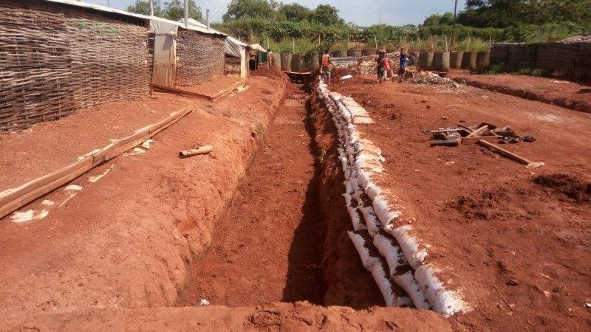
Roadway Stabilization

Slide 25
Lessons Learned:
The users should also be the designers
Small technical details matter more than we think
  Handrail height difference of 20 cm makes difference to person trying to lift themselves into a wheelchair
  Gradual slope of drainage bank seen differently by engineer looking at water flow and visually impaired person who could fall in without hard warning edge
“Sitting in a chair is different than looking at a drawing of the same chair”

Slide 26
QUESTIONS FOR CCCM SOUTH SUDAN?

Slide 27
Inclusion of persons with disabilities in decision making
ensure persons with disabilities, their families, and OPDs participate in identifying barriers that impede access for persons with disabilities, and in planning, designing, implementing, monitoring and evaluating shelter and settlements programs
establish criteria for inclusion of persons with disabilities and their care-givers in community decision making structures and processes
ensure that persons with disabilities are fairly represented in formal and informal shelter and settlements activities
involve persons with disabilities in the development of community participation mechanisms, and feedback and complaint mechanisms, to ensure effective and barrier-free access.
Resources: IASC Guidelines for inclusion of Persons with Disabilities in Humanitarian Action, All Under One Roof

Slide 28
Discussion questions (from survey)
How often do you manage to include design for people with disabilities in shelter & settlements programs?
As the GSC moves towards tools and policies development, how to make sure these are actually known and used by national shelter clusters and actors?
How to ensure these initiatives are also closely linked to the IASC Guidelines roll out?
How to make sure these initiatives actually benefits persons with disabilities, how to monitor this?
Notes:
Questions from survey

Slide 29

Next steps and ongoing activities for the WG
Webinars/ online sharing in working group calls from the field – to be informed by field staff priorities and questions
Integrate disability inclusion into all GSC guidance (esp at country level)
Integrate disability inclusion concerns into regular shelter/ NFI trainings.
Reviewing IEC from an inclusion point of view (IEC compendium project)
Field consultancy in CXB: field level investigation around how inclusion of persons with disabilities is currently mainstreamed within shelter and settlements programming.
Ongoing research and evidence sharing
For more information and to contribute contact:
  disability.inclusion@sheltercluster.org

