Slide 1


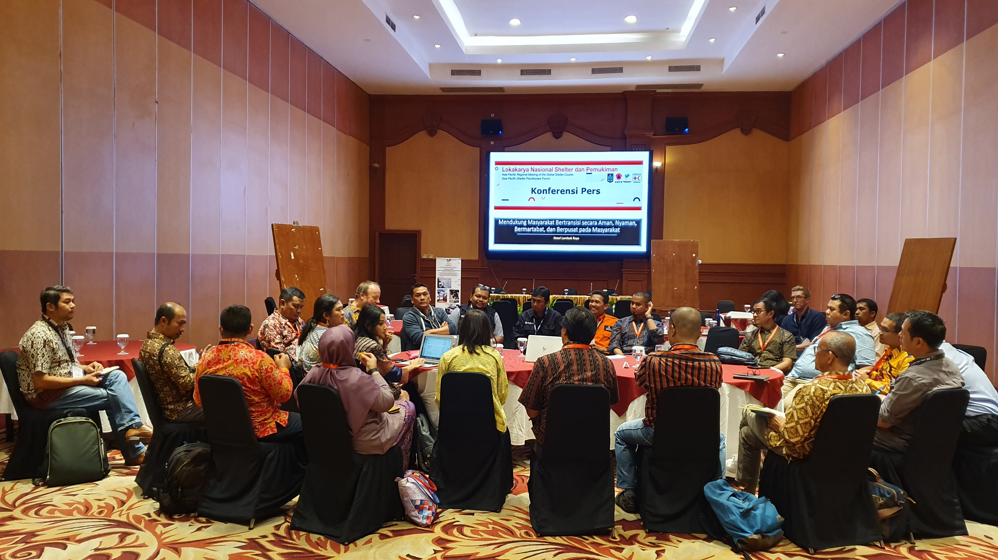
Shelter Sub Cluster in Indonesia
KEMENTERIAN SOSIAL
REPUBLIK INDONESIA
The journey to paradigm shift

Slide 2
KEMENTERIAN SOSIAL
REPUBLIK INDONESIA
Shelter Sub Cluster
is
The Indonesian national mechanism for coordinating shelter disaster assistance.
It is led by the Ministry of Social Affairs under the Protection and Displacement Cluster

Slide 3


Shelter Sub Cluster
Coordination
150,973 HH
Non-Government Shelter Assistance 2018 - 2020
Disaster Response in Central Sulawesi
15,318 HH
1,474 HH
± 632,444 Billion IDR
2018 Sunda Strait Tsunami
2020 Great Floods in Jakarta, Banten, and West Java
Disaster Response
in West Nusa Tenggara (NTB)
Emergency Shelter
Temporary Shelter
Permanent Housing
Funds
1,000,000+
people assisted
21,725
KK
25,803
KK
83
KK
± 486,473
Billion IDR

Slide 4



Shelter Sub Cluster
Organisational Structure
Minister of Social Affairs
STAG
Director General
Director
GSC Support Team
Shelter Sub Cluster Support Team
Provincial Social Affairs Office
Head of Sub-Directorate
Provincial Social Affairs Office
Cluster Support Coordinator
National Cluster Support Coordinator
NTB Cluster Support Coordinator
Admin Officer
IM Coordinator
Technical Advisor
IM Coordinator
Comms Coordinator
IM Coordinator
Roving Support Coordinator
Admin Coordinator
Admin Officer
Comms Assistant
Palu
Hub
Sigi
Hub
Donggala
Hub
Asbestos Advisor
Recovery Advisor

Slide 5
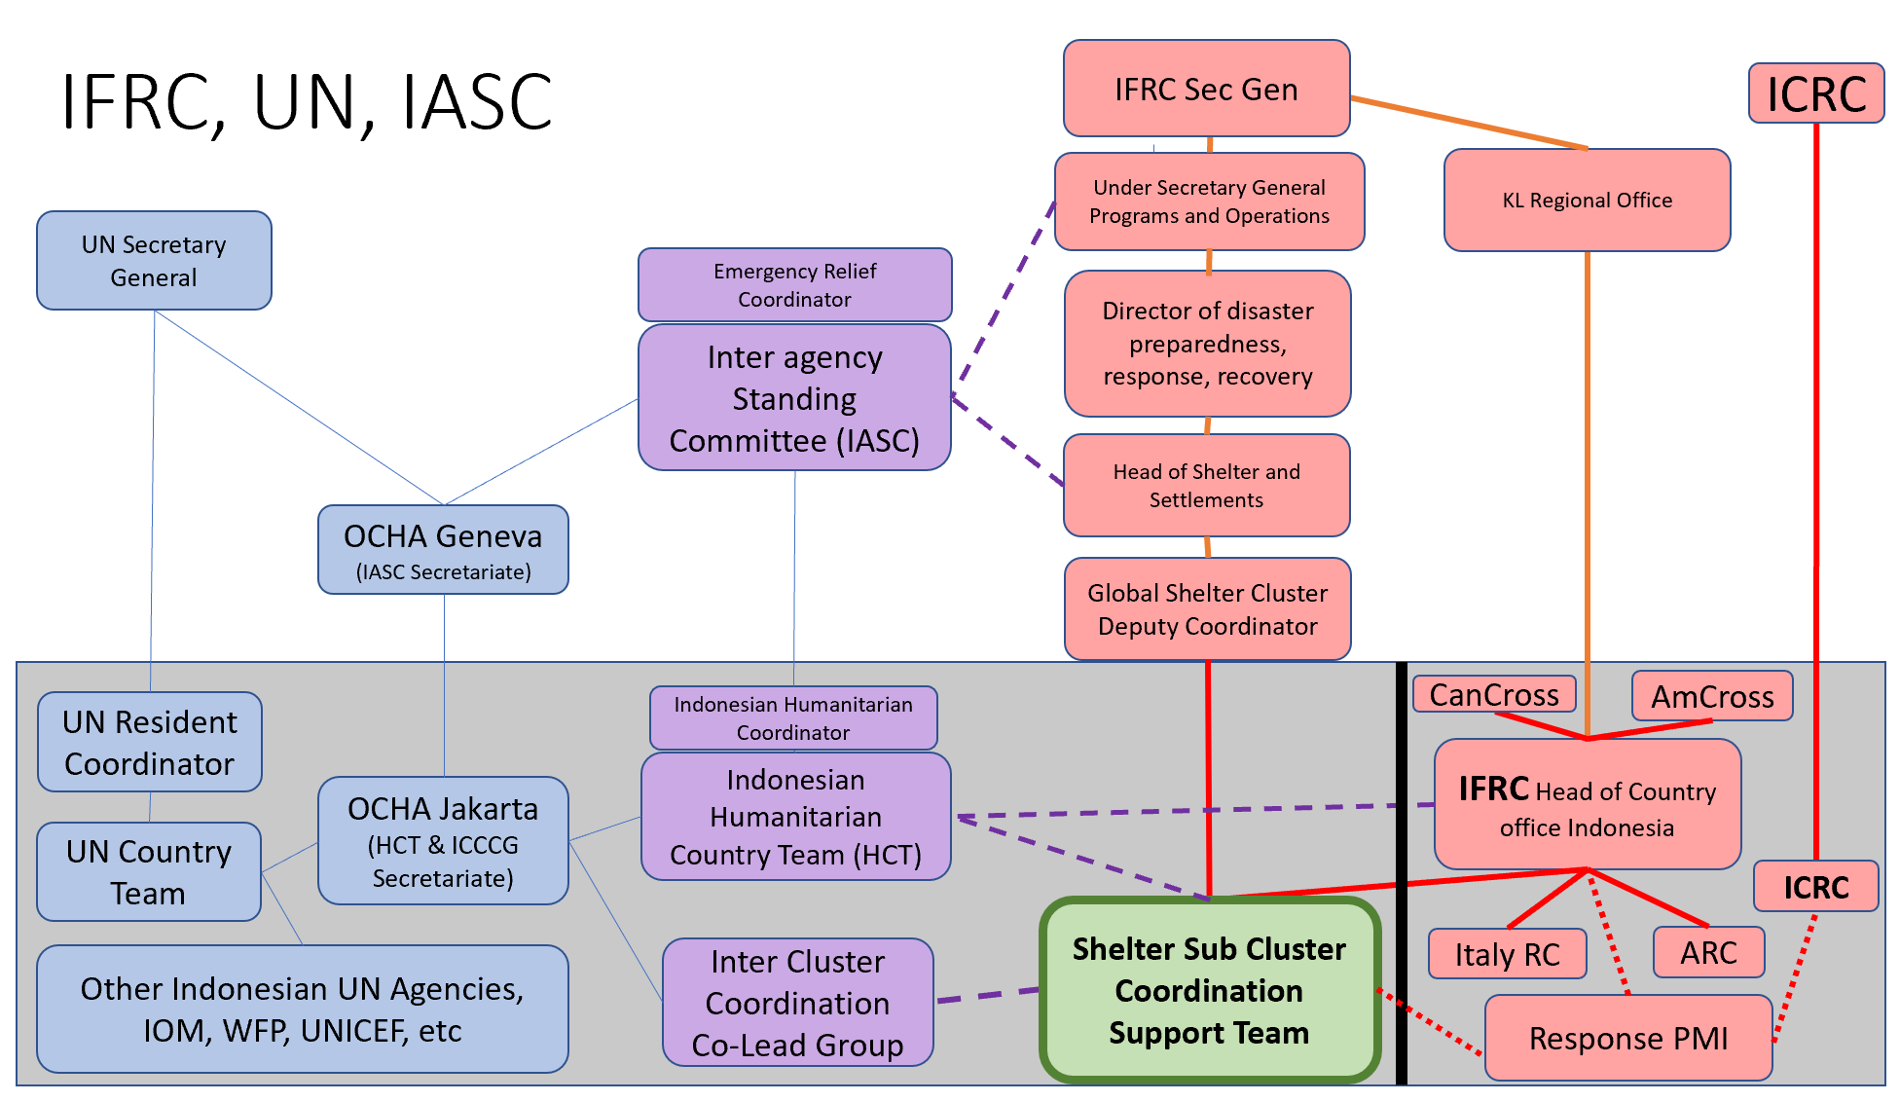
Shelter Sub Cluster
Firewall between Implementation and Coordination

Slide 6


Shelter Sub Cluster
Coordination
200+ humanitarian organisations
12
members of
The Strategic and Technical Advisory Group
Coordination Support team
Coordination Hubs
NGO district focal points
15
3
3
200+
Meetings facilitated over
2 yrs

Slide 7

Shelter Sub Cluster
Leading example of nationalized coordination
World leading example of localization of coordination
The largest national coordination platform for non-government actors
Leading inter-agency collaboration with other line ministries
All meetings chaired and facilitated by Indonesians in Bahasa Indonesia, with bilingual translation as needed
Maintaining an open, inclusive, and participatory atmosphere for all actors
Leading the paradigm shift from top down product driven aid to participatory process-driven flexible assistance

Slide 8
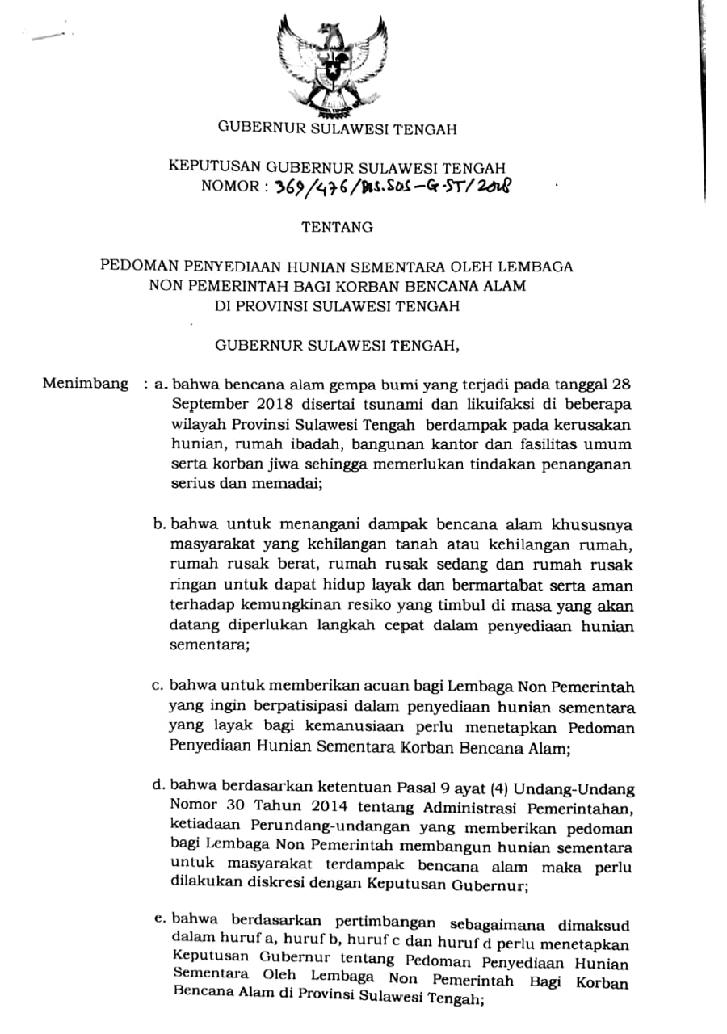
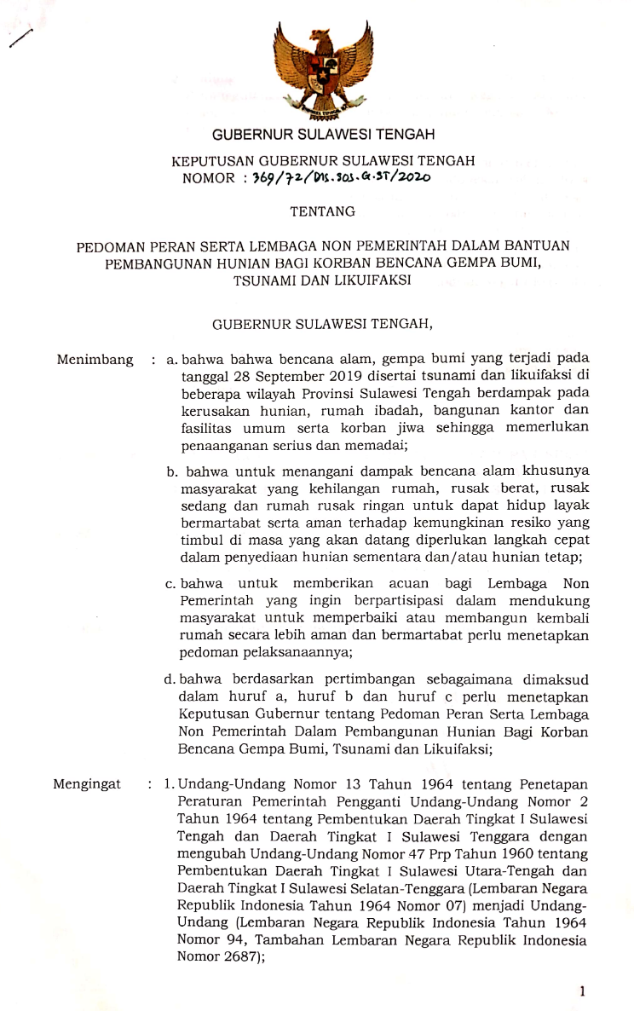


Shelter Sub Cluster
Policies and Standards
The first humanitarian shelter standards in Indonesia, approved by local government in Central Sulawesi
The first shelter recovery policies in Central Sulawesi outlining core principles, strategy, criteria, and assistance packages for NGOs
Notes:
One of the unique aspects of the nationalisation of the cluster system in Indonesia is that it has allowed Non-Government actors to assist the government in passing new laws, changing policies, and creating legislated standards rather than just common strategies and non-official guidelines as usually occurs in Non-nationalised clusters. This is also an example of Non Government actors collectively assisting local government to analysed local needs and create and adopt localised strategies. These flexible localised standards provide a framework for replication in future responses.

Slide 9
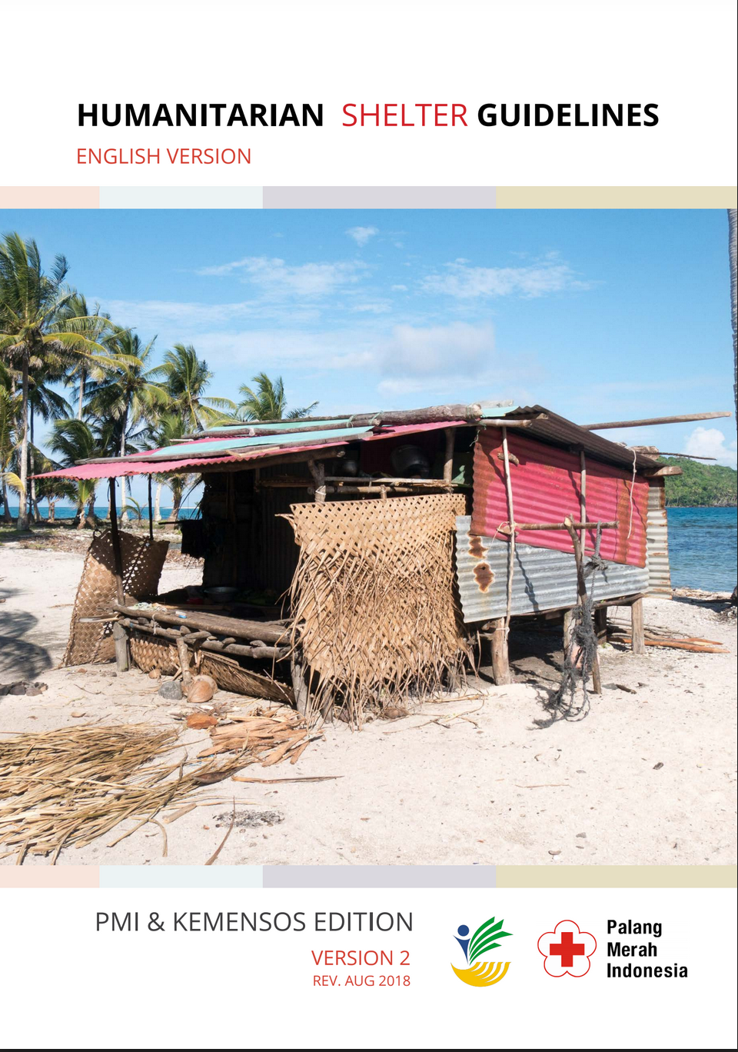
Shelter Sub Cluster
National Shelter Guidelines
In 2019, the Minister of Social Affairs officially launched the new National Humanitarian Shelter Guidelines
Provide an overarching framework for all future humanitarian shelter operations by non government actors in Indonesia
Developed in collaboration with the Indonesian Red Cross

Slide 10

Shelter Sub Cluster
Asbestos Guidelines
In 2019, the Minister of Social Affairs developed the first national guidelines on managing the risks of asbestos in humanitarian context
Aims to ensure the safety of the disaster-affected communities and the humanitarian actors assisting them
Developed in collaboration with WHO, UN OCHA, IFRC, and sub cluster partners, with inputs from the Ministry of Health

Slide 11


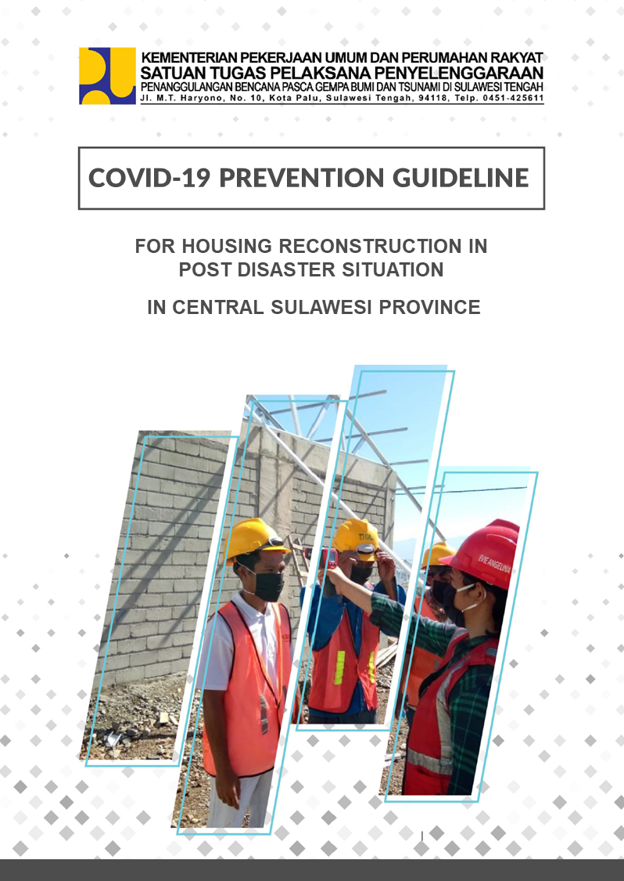
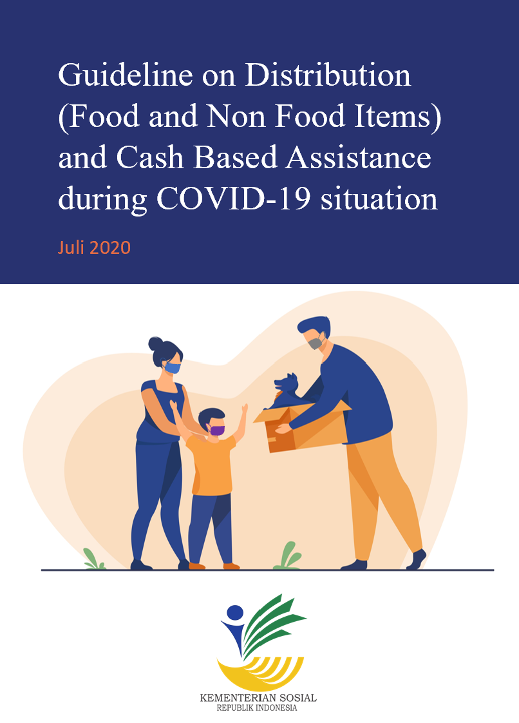
Shelter Sub Cluster
COVID-19 Guidelines
Guideline for Community Based Quarantine and Isolation
(MOSA, 2020)
Guideline for Humanitarian Workers and Volunteers
(MOSA, 2020)
Guideline for Housing Reconstruction in Post Disaster Situation
(MPWH, 2020)
Guideline on Distribution and Cash Based Assistance (MOSA, 2020)

Slide 12
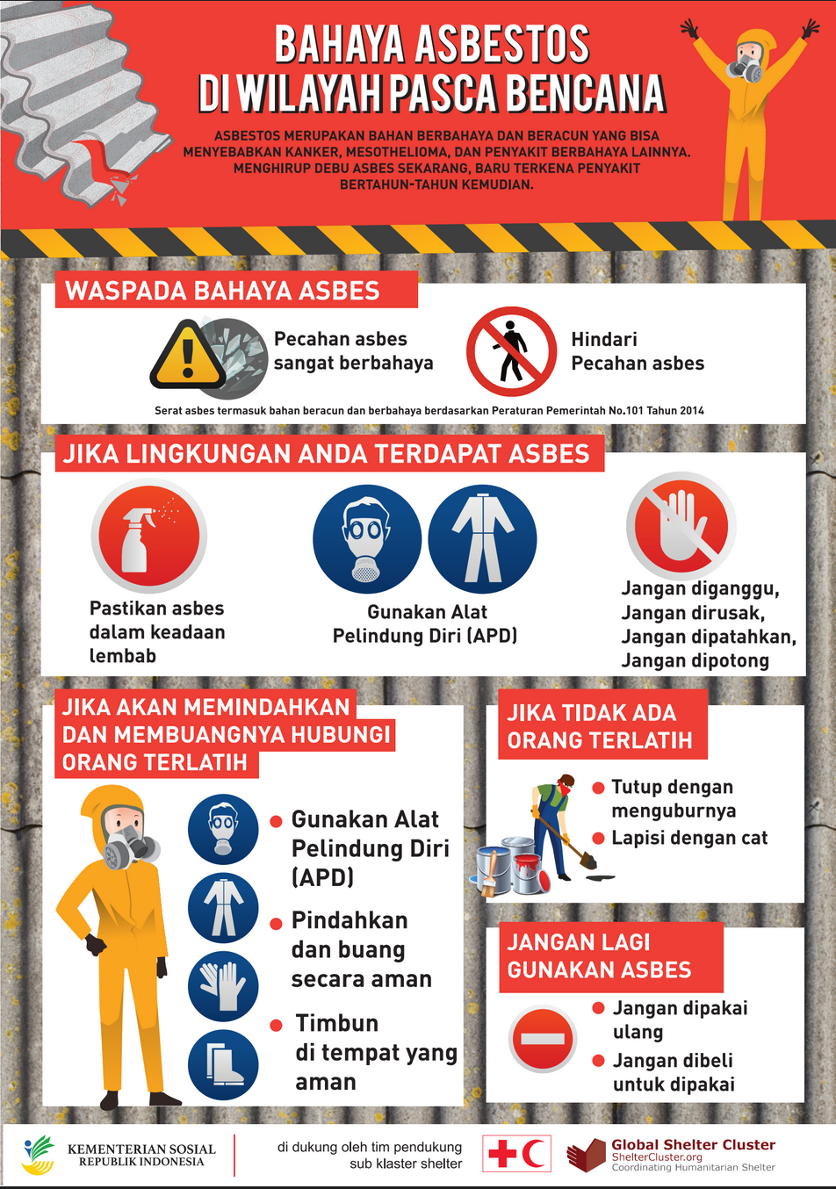
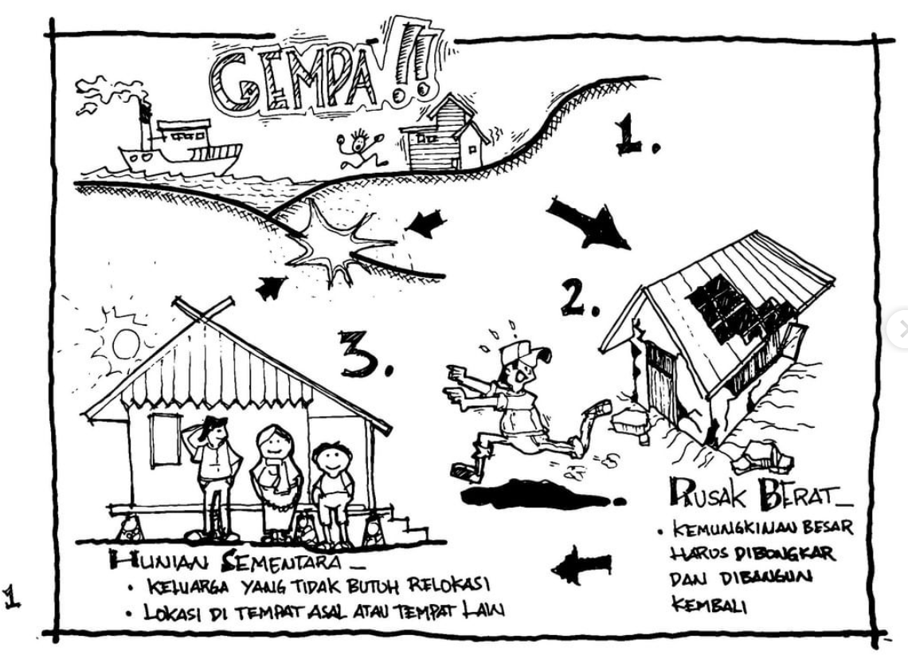
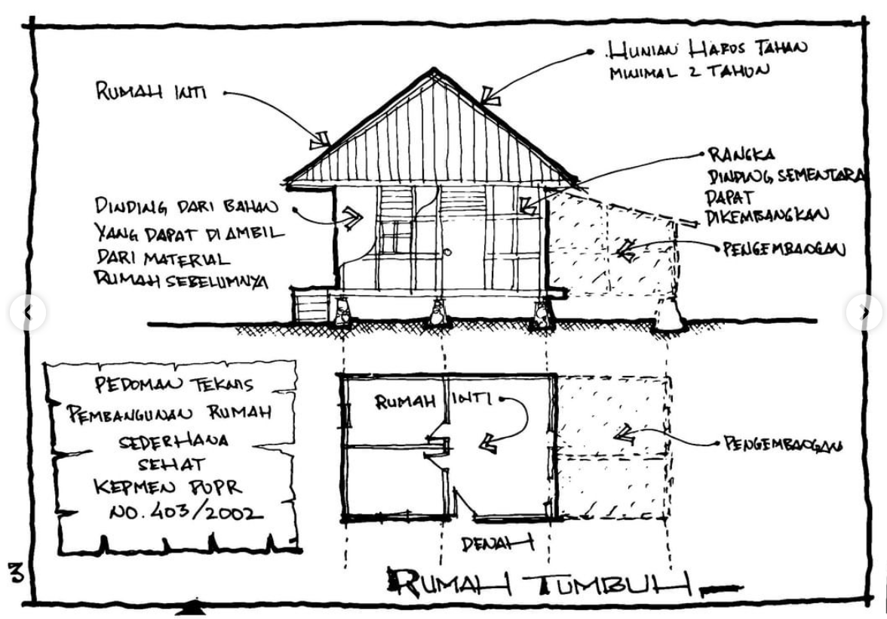
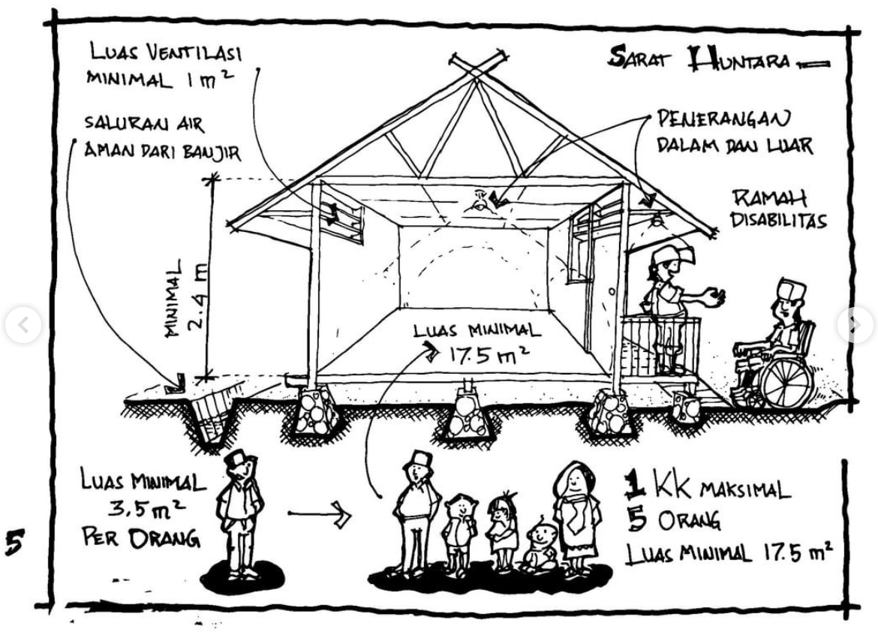
Shelter Sub Cluster
IEC Materials
Inter-agencies Build back safer Campaigns
The first government-endorsed communication material on asbestos awareness and risk reduction

Slide 13

Shelter Sub Cluster
Coordination during COVID-19
Topics covered:
Shelter strategy on COVID-19 situation
Roles of private sector (hotels, apartments, beds and breakfasts)
Shelter and child protection during COVID-19 situation
Community-based shelter assistance
Psychosocial support and mental health
Quarantining for boarding schools
Inclusion guideline
Town-hall style discussion
Capacity building initiative
Post disaster reconstruction
Evacuation guideline
IT services for shelter
Parallel disasters
Ongoing recovery
20
Online Meetings as of 16 September 2020

Slide 14
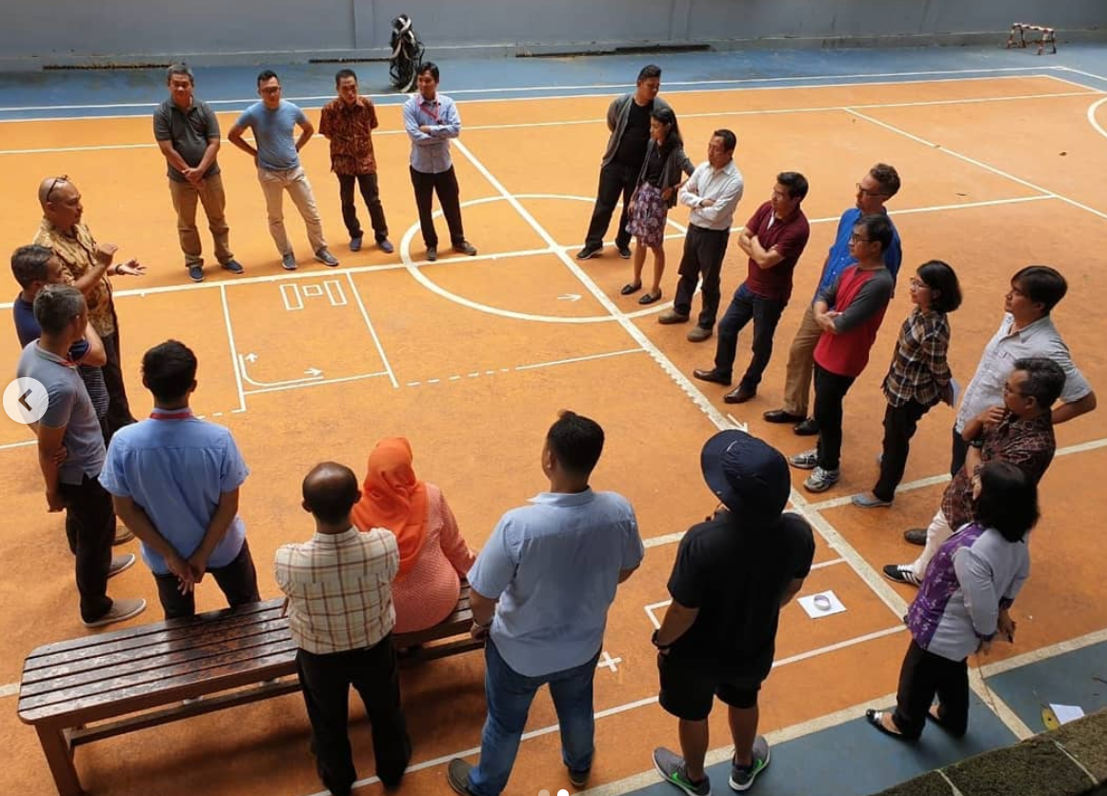
Shelter Sub Cluster
Capacity Strengthening
Women in Reconstruction
Shelter Coordination Skills
TAGANA Training
Shelter in COVID-19
Build Back Better
Shelter and Settlements
Communication Skills
Safety for Aid Workers

Slide 15


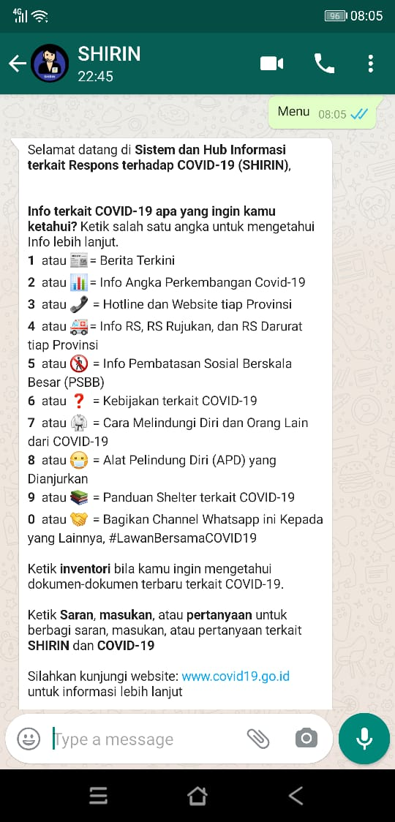
Shelter Sub Cluster
SHIRIN
System and Hub of Information on Response for COVID-19
An automatic computer program to assist users in finding information quickly and reliably
Can be accessed through: bit.ly/HaiShirin
1 or 📰= Latest News 2 or 📊= Latest Figures on COVID-19 3 or 📞 = Hotline and Website of Each Province 4 or 🚑= Info on Hospitals, Referral Hospitals, and Emergency Hospitals 5 or 🚷 = Info on Lockdowns 6 or ❓ = Policies related to COVID-19 7 or 🥋 = How to Protect Yourself and Others from COVID-19 8 or 😷 = Recommended PPEs 9 or 📚 = Shelter-related Guidelines for COVID-19 0 or 🤝 = Share this Channel to Others

Slide 16
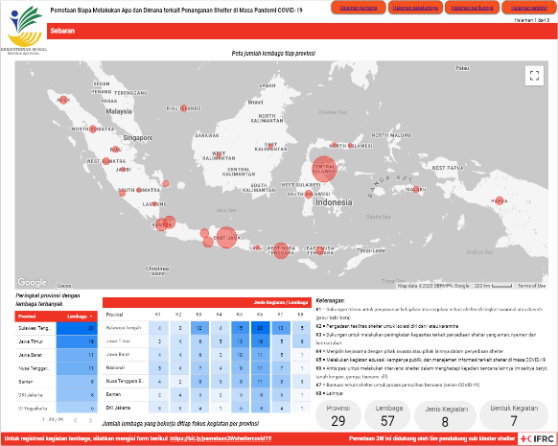
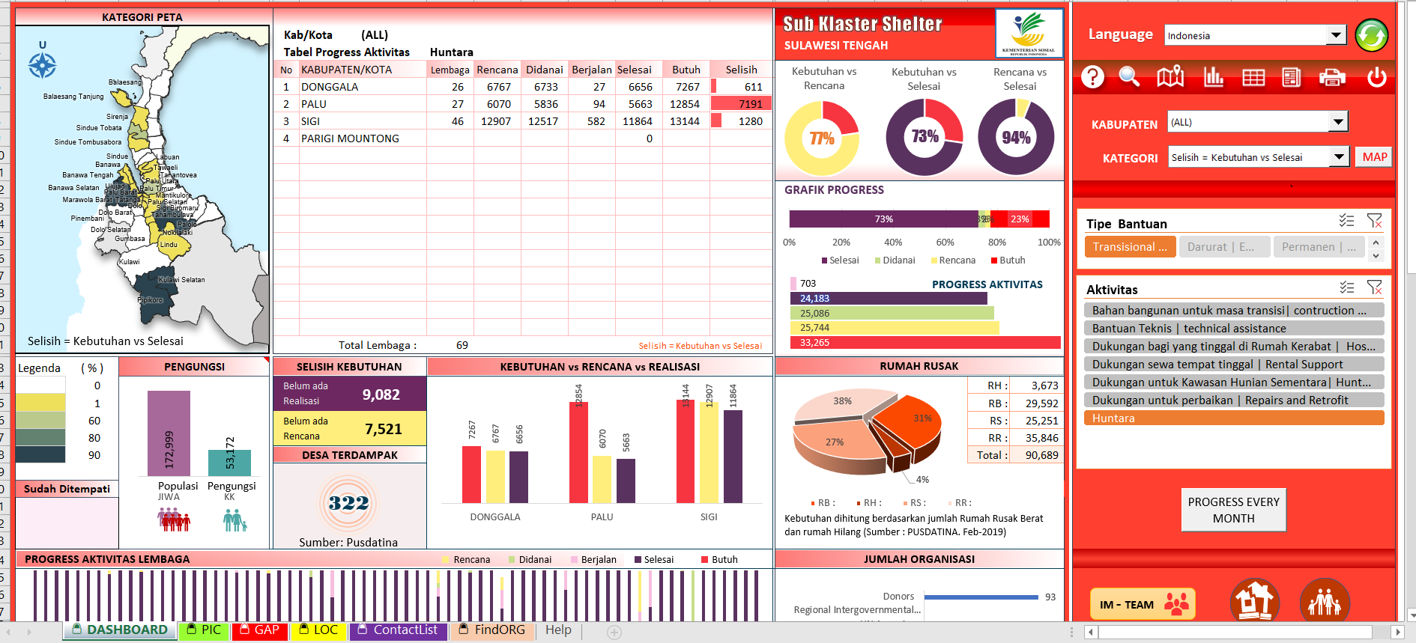
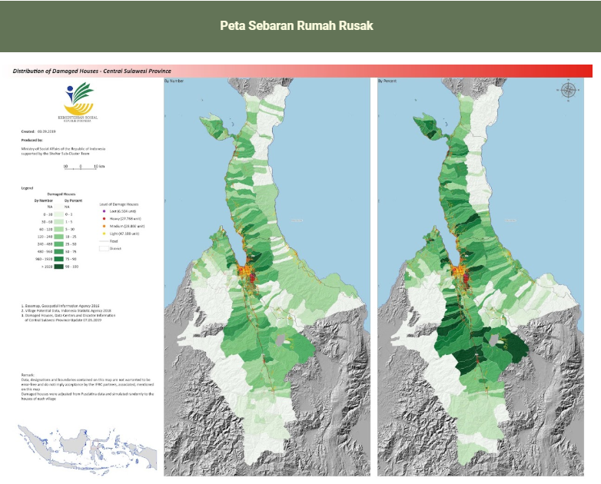
Shelter Sub Cluster
IM tools and products
Online Dashboard
COVID-19 Dashboard
Mapping

Slide 17
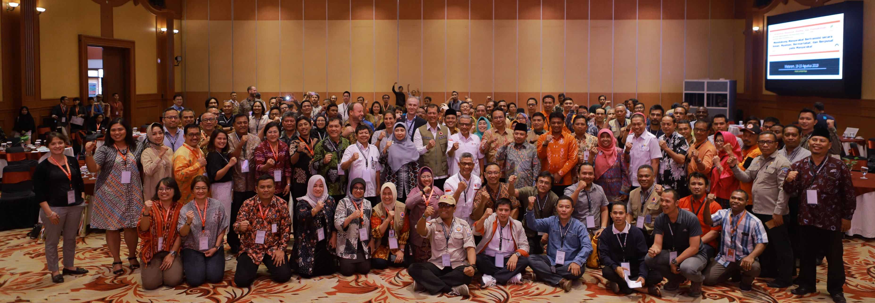
Shelter Sub Cluster
Shelter Week 2019
Shelter National Workshop
2019 Asia Pacific Shelter Practitioners Forum
40+ international participants
200+ participants
Regional Meeting for the Global Shelter Cluster
Field Visit to the Earthquake Affected Area in Lombok
Inter-ministerial collaboration
80+ humanitarian organisations

Slide 18
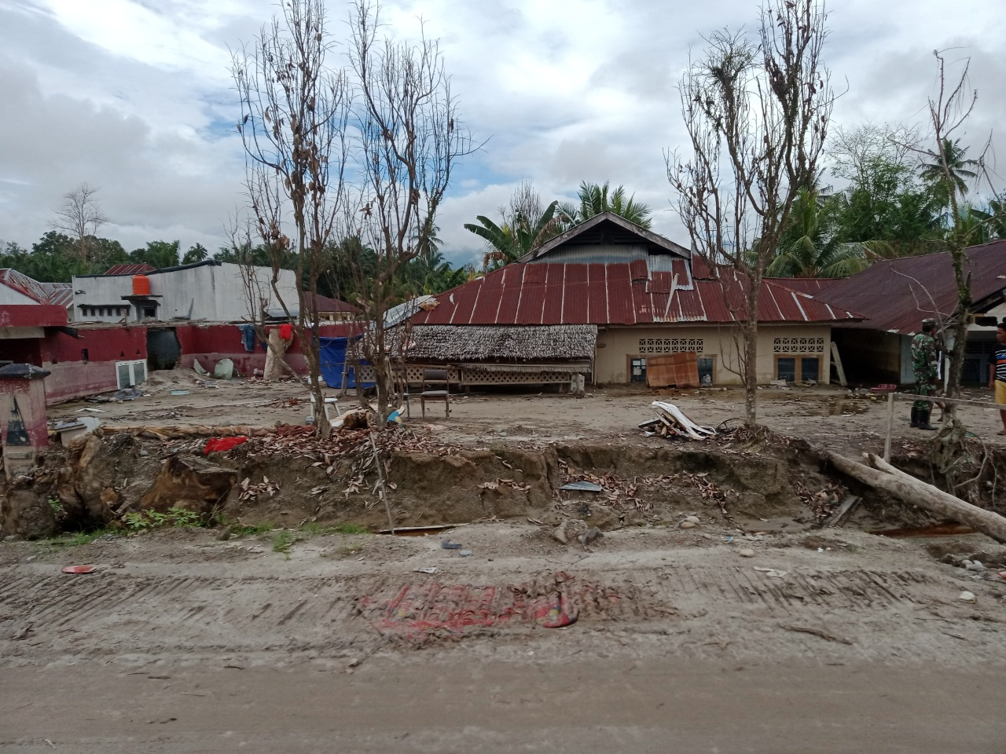
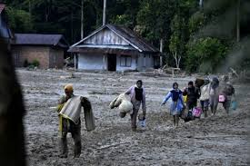
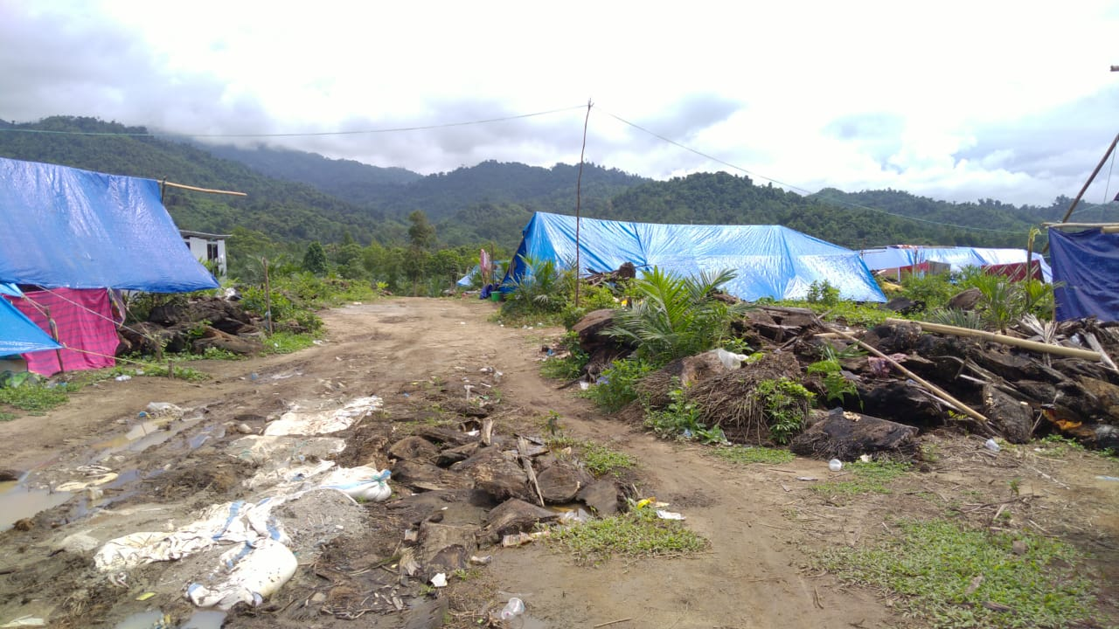
Shelter Sub Cluster
Challenges and Lessons Learned

Slide 19
Thank You
KEMENTERIAN SOSIAL
REPUBLIK INDONESIA
The Indonesian National Shelter Sub-Cluster is coordinated by the Ministry of Social Affairs With support from IFRC, Shelter Coordination Support Team and the Global Shelter Cluster
For more information ask Shirin at https://bit.ly/HaiShirin

