Slide 1
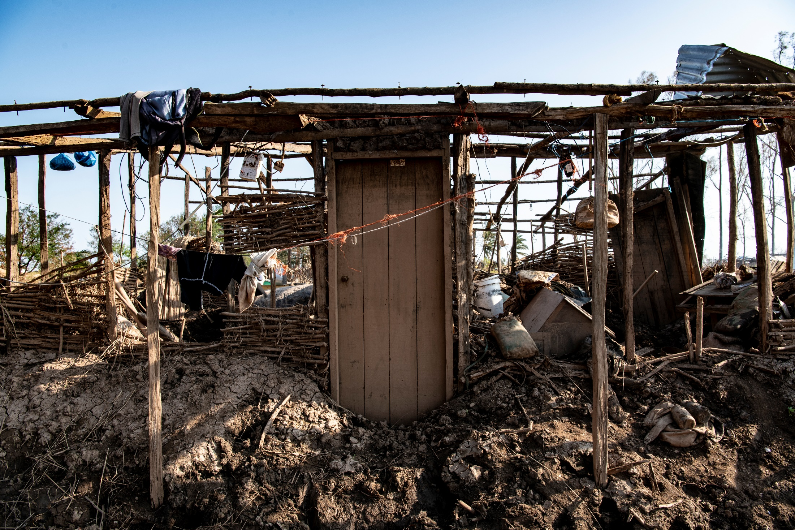

MOZAMBIQUE SHELTER CLUSTER MARKET ASSESSMENT
Idai Cyclone Response
October 8, 2020
Global Shelter Cluster NFI
Working Group Meeting

Slide 2
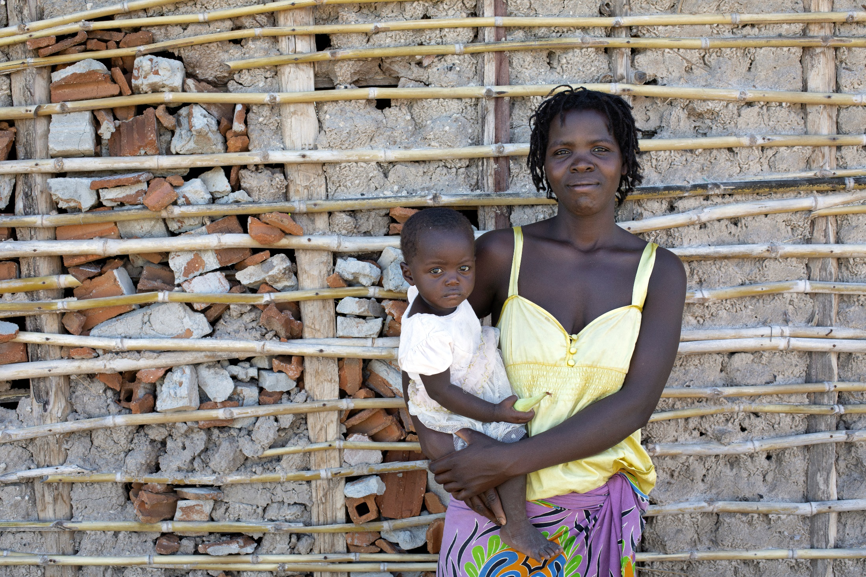
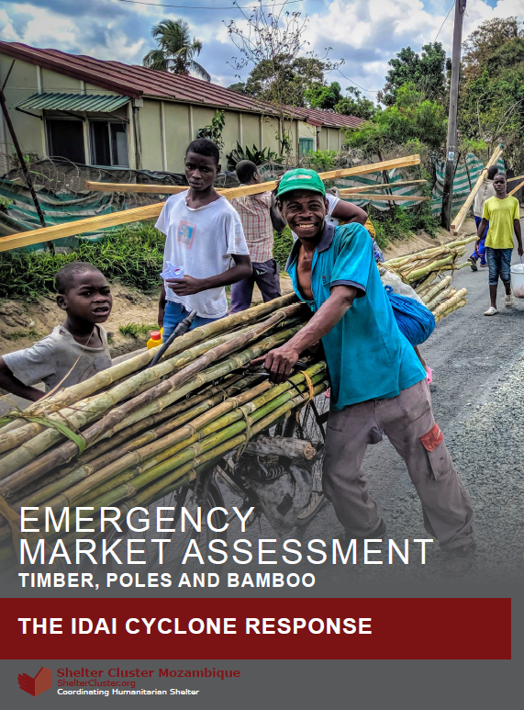
Today’s content
Background
Methods
Findings
Recommendations
Q/A
Notes:
Presenter: Christopher.Reichert@crs.org
Supporting team: seki.Hirano@crs.org and Jennifer.weatherfield@crs.org
Last year, CRS had the pleasure of working with the Mozambique shelter cluster to coordinate the Emergency Market Assessment for the Idai Cyclone Response.
Today, we are pleased to present some of the content from the report.
We will quickly cover the assessments' background and methods and spend more time on the key findings and recommendations.

Slide 3
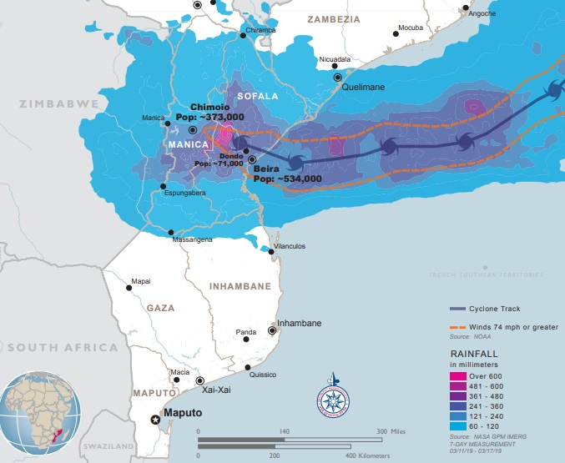
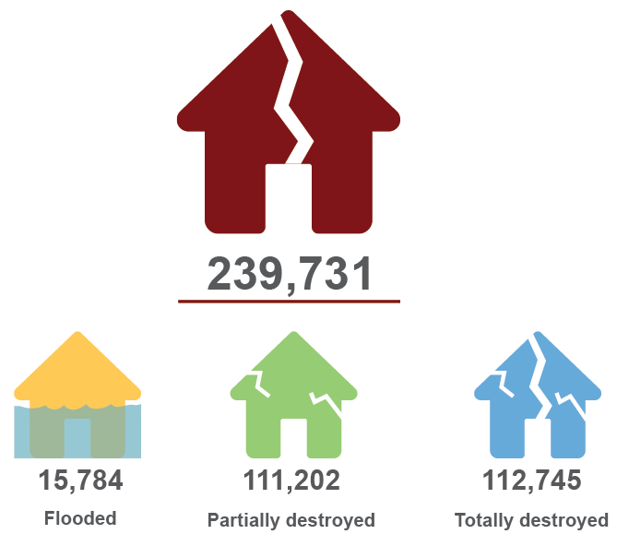
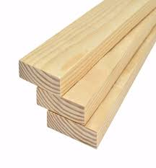


Background
Background
Notes:
In March 2019, 1.5 million people were affected by Cyclone Idai.
Across four provinces, an estimated 240,000 homes were affected.
Of those, half were destroyed completely, and half were partially destroyed.
Through a rapid market assessment, the government of Mozambique and its partners wanted to better understand critical market chains.
This report assessed the capacity of markets to supply key inputs to the Idai-affected populations across two provinces and eight local markets.
The assessment looked at 3 value chains – timber, poles and bamboo.

Slide 4
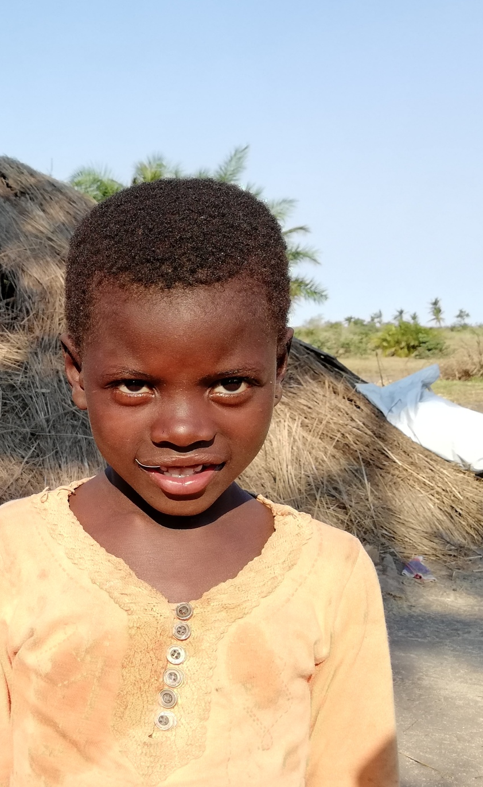











Methods
44
99
Notes:
The assessment included qualitative and quantative methods.
The qualitative portion included 44 key informant interviews with five entities.
Interviews were held with government, multilateral institutions, NGOs, vendors and communities.
The quantitative portion used a structured survey through Kobo to collect information from nearly 100 vendors on 30 variables, across four domains.
The domains were: vendor and client profiles, vendor payment options and terms, current stock levels, and pricing data.
Pricing data was divided into current retail prices, current wholesale prices and pre-Idai pricing to better understand the impact of Idai on markets

Slide 5
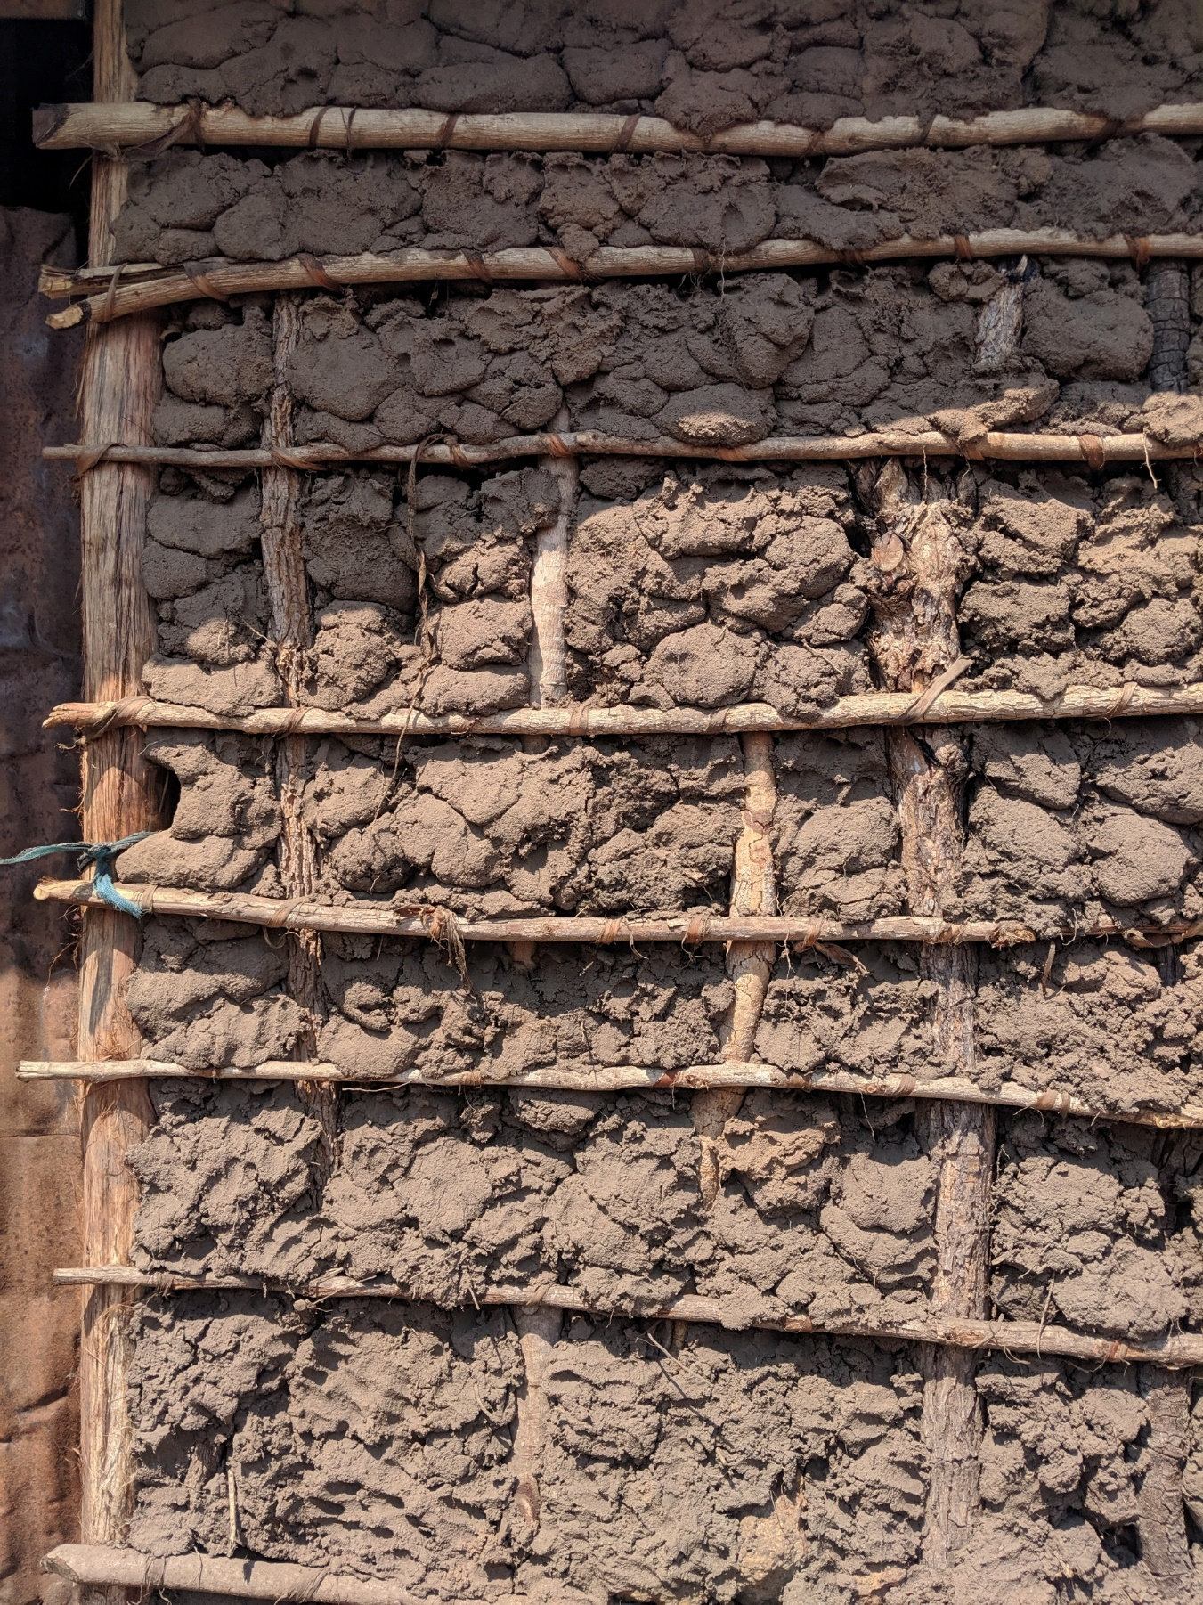
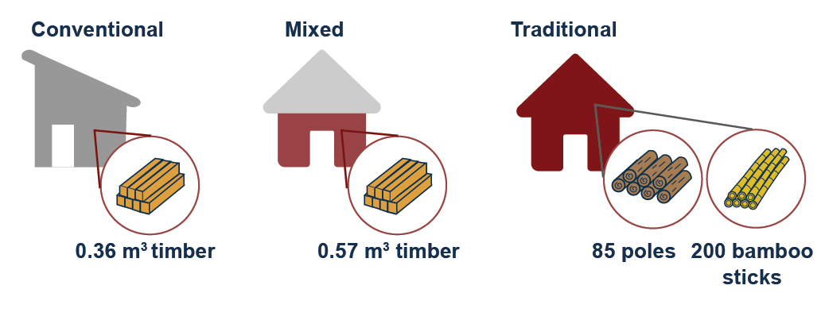
Projected needs
130k 20k 30k
60k m3 1.5m 2.2m
Notes:
The first step was to create a projection of needs the value chains based on a set of variables and assumptions.
Interviews and a lit review helped classify need into 3 typologies: conventional homes, mixed and traditional homes.
The assessment also took into account variables such as: self-recovery rates and shifts in typologies.
For example it was known that some percent of traditional homes would be rebuilt into conventional homes.
This led us to assume that support will be need for 179,158 households
Of which 130k would be conventional, 20k mixed, and 30k traditional
Therefore total input needs reached: 60,000 m3 of timber, 1.5 million poles, and just over 2 million bamboo sticks.
For perspective, each 30-ton truck can carry enough timber for about 100 HH, 1,800 truck loads to meet total need.
Additional detail:
57,255m3 of timber, 1,355,742 poles, and 2,232,987 bamboo sticks.
(127,056 conventional, 20,202 mixed, and 31,900 traditional homes).

Slide 6
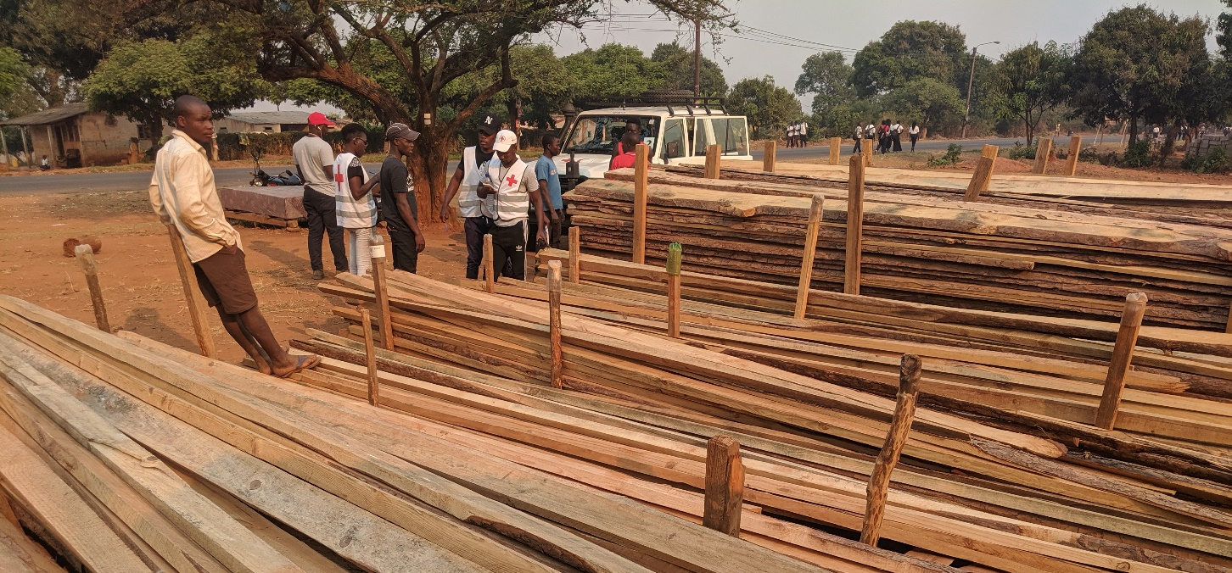





Findings - vendors
Notes:
In general, the assessed vendor profile is dominated by informal merchants, cash business, low stock levels, poor storage practice, and vendor-centric terms (100% pre-payment).
All studied market chain items were found in the markets, but in varying levels of quality.
Markets off the main inter-provincial axis had negligible quantities and inferior qualities.
The photo highlights the storage conditions, quality and supply at that point in time.
We see this retail vender is selling 2nd and 3rd tier quality wood from IFLOMA at a fairly high cost.

Slide 7
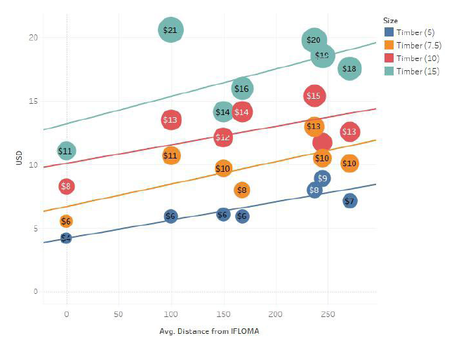

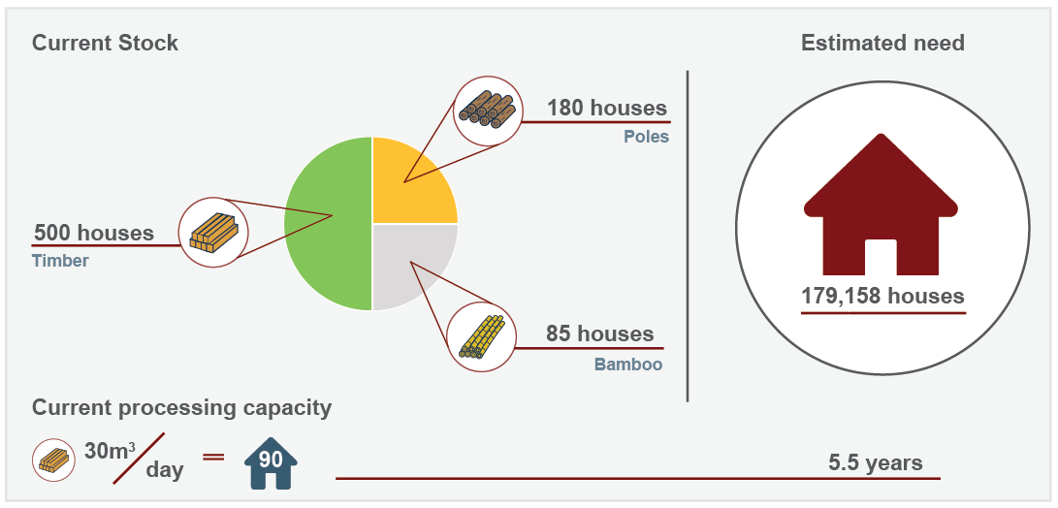
Findings – supply/pricing
Notes:
IFLOMA is the main integrated pine timber player in the affected area, and is essentially a monopoly.
They focus on production, value addition, exploration and licensing, and consumer retail.
The company maintains a sawmill, kiln, and treatment facilities, and manages a large swath of land covering 31,000 hectares.
Although supply is plentiful, processing was capped at 30m3 per day
This production is a bit more than one 30-ton truck per day. or the equivalent timber for 90 conventional houses.
At this rate, total timber needs would take 5.5 years to process.
As expected, prices were commensurate with distance from IFLOMA.
By plotting price vs distance from IFLOMA along with various timber sizes, we can visualize this relationship.
Aside from pricing implications and processing ability, the report assessed current stock.
Vendors current total stock was estimated at 50,000 items, half in timber, a quarter in poles, and a quarter in bamboo.
Current timber stocks would yield enough for about 500 houses; poles for 180 houses; and bamboo for 85 houses.
Stock-outs and delays were common, unless pre-payment for shipments were made well in advance.

Slide 8
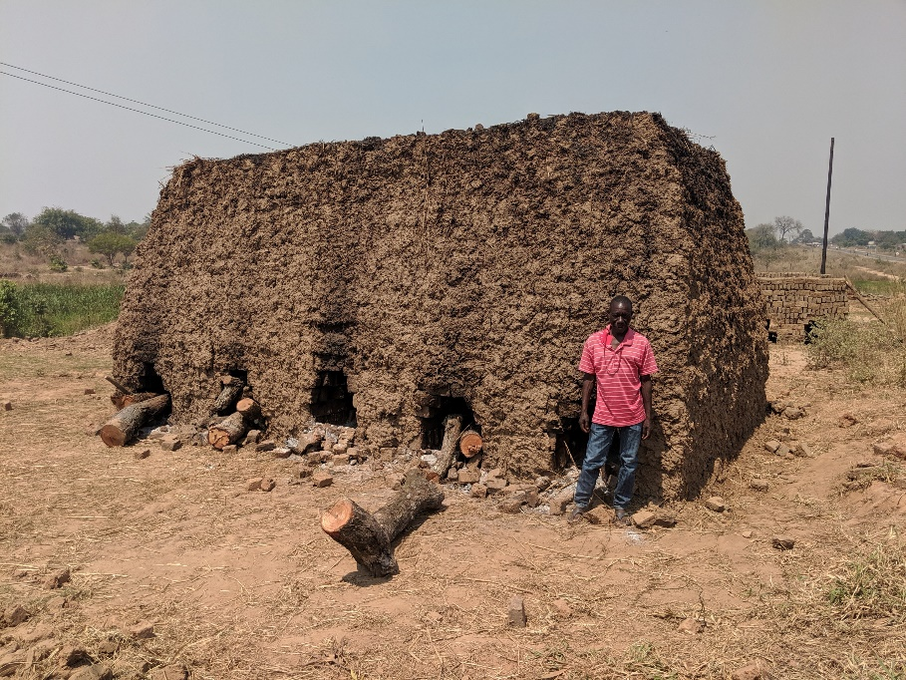
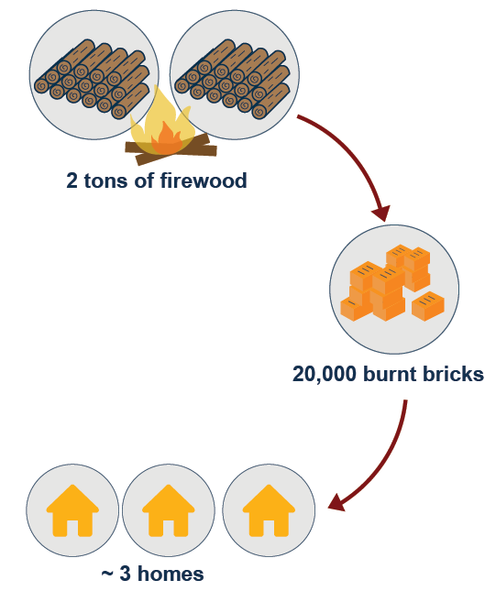
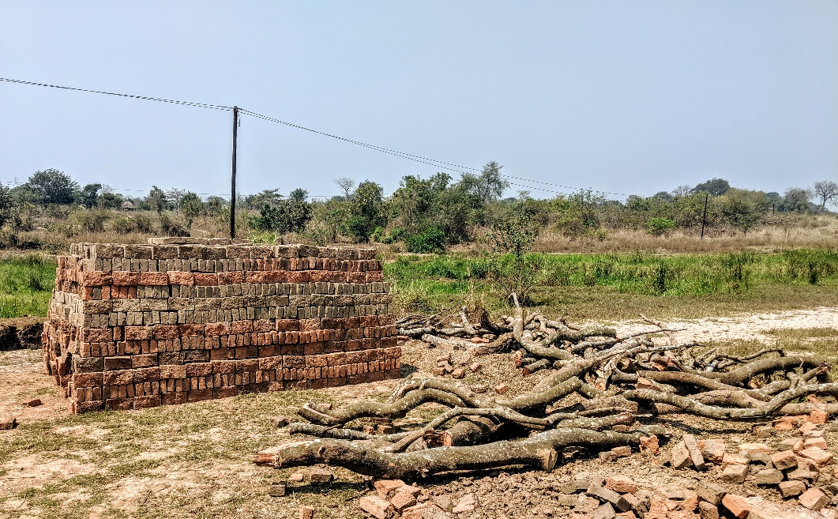
Findings – environment
Notes:
Although beyond the scope of the assessment, indicative data was collected on fuel needs for burnt brick production.
It takes about 2 tons of large girth, mature wood to make 20,000 bricks for 3 homes.
For this one area visited, 2,300 tons of wood would be needed to fire the blocks for 4,600 resettlement houses.
The area visited was adjacent to forest reserves, which had already seen impacts from wood cutting.

Slide 9


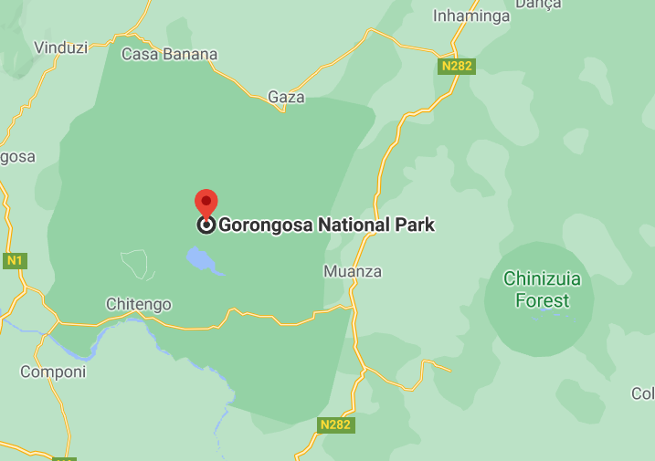

Findings – an alternative
Notes:
A company called Levas Flor has a large sustainable forest concession near Gorongoza national park.
Levas Flor manages 20 blocs in two districts, harvesting one block per year, only returning to that block 20 years later.
The level of rigor appears high as they are Forest Stewardship Council certified
GPS coordinates of each felled tree can be provided,
Commercial production was 8,000m3, of which about 70% is miombo.
Although having a greater sawing capacity and sustainability advantages, cost and demand may be factors to consider.
LevasFlor’s average cost per cube was nearly three times that of IFLOMA pine.
Also, communities view miombo as firewood and charcoal, and less conducive for construction timber.

Slide 10
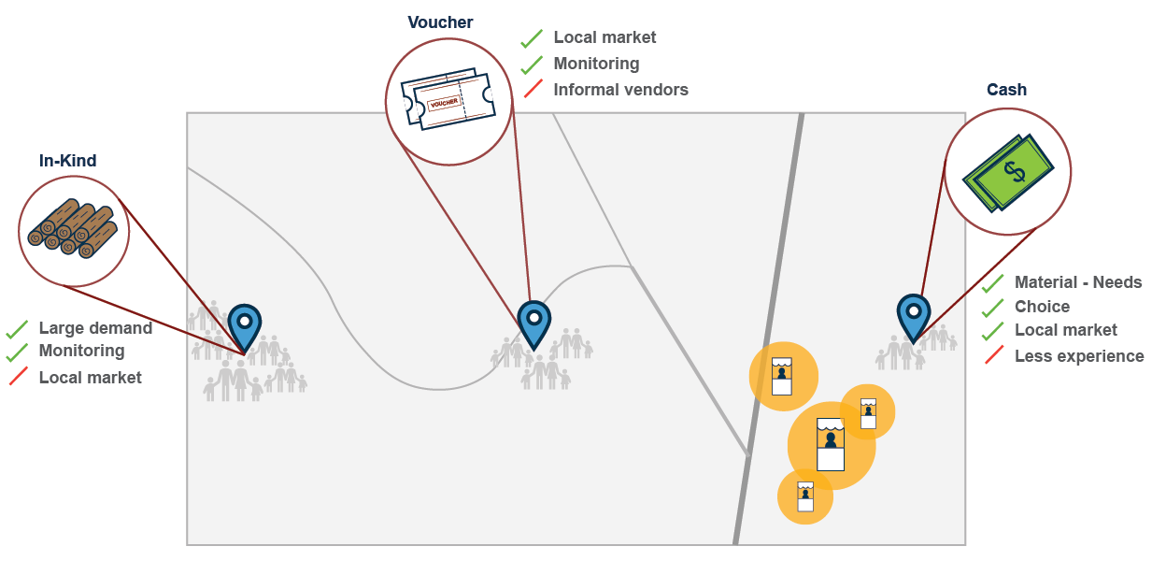
Recommendations – modalities
Notes:
Before covering the top 10 recommendations, let’s focus on modalities.
The cluster should consider a mixed approach for meeting the timber, pole and bamboo needs by layering in various modalities.
These include: conditional cash and voucher pilots along with local, regional and intl in-kind purchases
First, the market for timber was very thin, suggesting large scale surge demand could be met by in-kind support.
Assuming processing can be increased, the centralized nature of the monopoly, provides a quality control check, and certain economies of scale – especially for the more distant communities.
However, in-kind distributions would not support local markets.
Most of the major players were using in-kind distributions for the emergency and transitional phases.
Second although there was interest in working with vouchers by formal vendors, there was little experience.
Formal vendors held reservations on payment.
Some highlighted that previous experience led to cash flow issues as payments were made very late by certain entities.
Although monitoring would be relatively easier than the cash modality, it would exclude informal vendors.
Finally, the study highlighted that cash should also be considered as an option available to partners.
A cash modality is likely to better match individual needs with supply, emphasizing choice, supporting local markets, and small vendors.
Although a few pilots had been done locally, there was far less experience with this type of approach.
Some expressed concerns around quality control, which would need to be addressed through TA and/or conditionalies

Slide 11
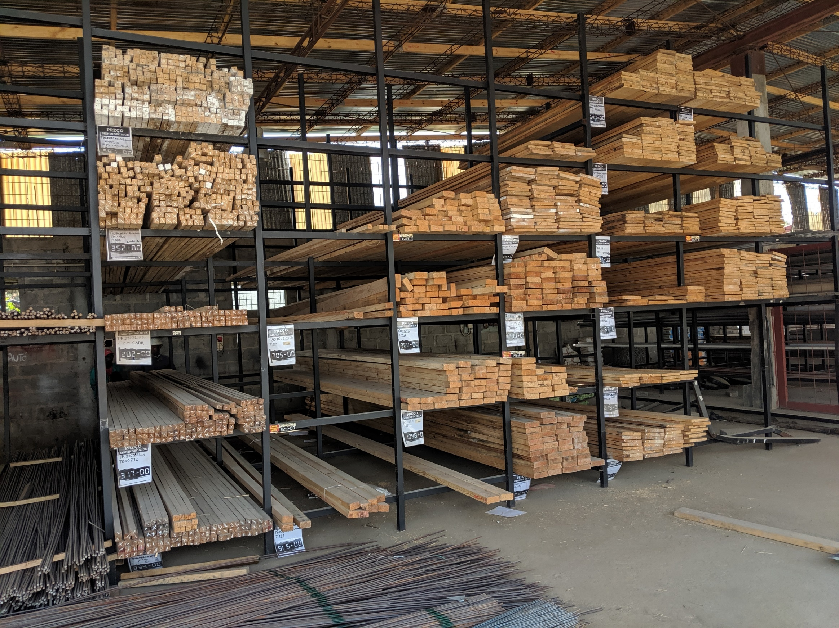
Recommendations
Tipping point
Monopoly
Vouchers
Qual control
Bamboo
Notes:
Due to transport and logistical demands, bulk orders from IFLOMA make fiscal and logistical sense at a certain tipping point, which ranges from 50 to 100 houses, depending on size.
Larger scale responses will need close collaboration with IFLOMA to ensure demand can be met. Relying on local market actors for large amounts of pine is not feasible.
For smaller-scale responses, consider piloting a shelter kit voucher program with established multi-branch retail stores. Start with those homes closest to the retailer, and provide transport support through cash. Retailers concerns on timely payment will need to be addressed.
Quality control of timber will be a crucial component with any modality. The markets contain a variety of qualities, including second and 3rd tier pine sold from IFLOMA. That said, if lower quality pine cuts are options from a technical point of view, this may be a way to reduce input costs considerably.
Of the three market chains assessed, bamboo is the best candidate for a market-based response especially in those areas that a) habitually use bamboo, b) live close to bamboo sources. The cash injection would support disposable income to those in the value chain and reduce logistical complications for partners.

Slide 12
Recommendations
Market support/strengthen
Community education
Additional study – esp burnt bricks
Market pulse
Balancing factors
Notes:
Consider market support activities such as increased sawing capacity, and supporting local vendors with storage capacity and methods.
During distributions, provide education to beneficiaries on choosing materials, particularly around input quality and end-user storage.
Considering a larger environmental impact study on burnt bricks prior to designing programs with this input
Continue to conduct light, inter-agency market assessments that drawn upon the strengths of each agency to help with ideation for solutions.
Support decision makers in how to balance key factors: such as: environmental costs, price, and the opportunity costs associated with timely service provision and the humanitarian imperative.

Slide 13
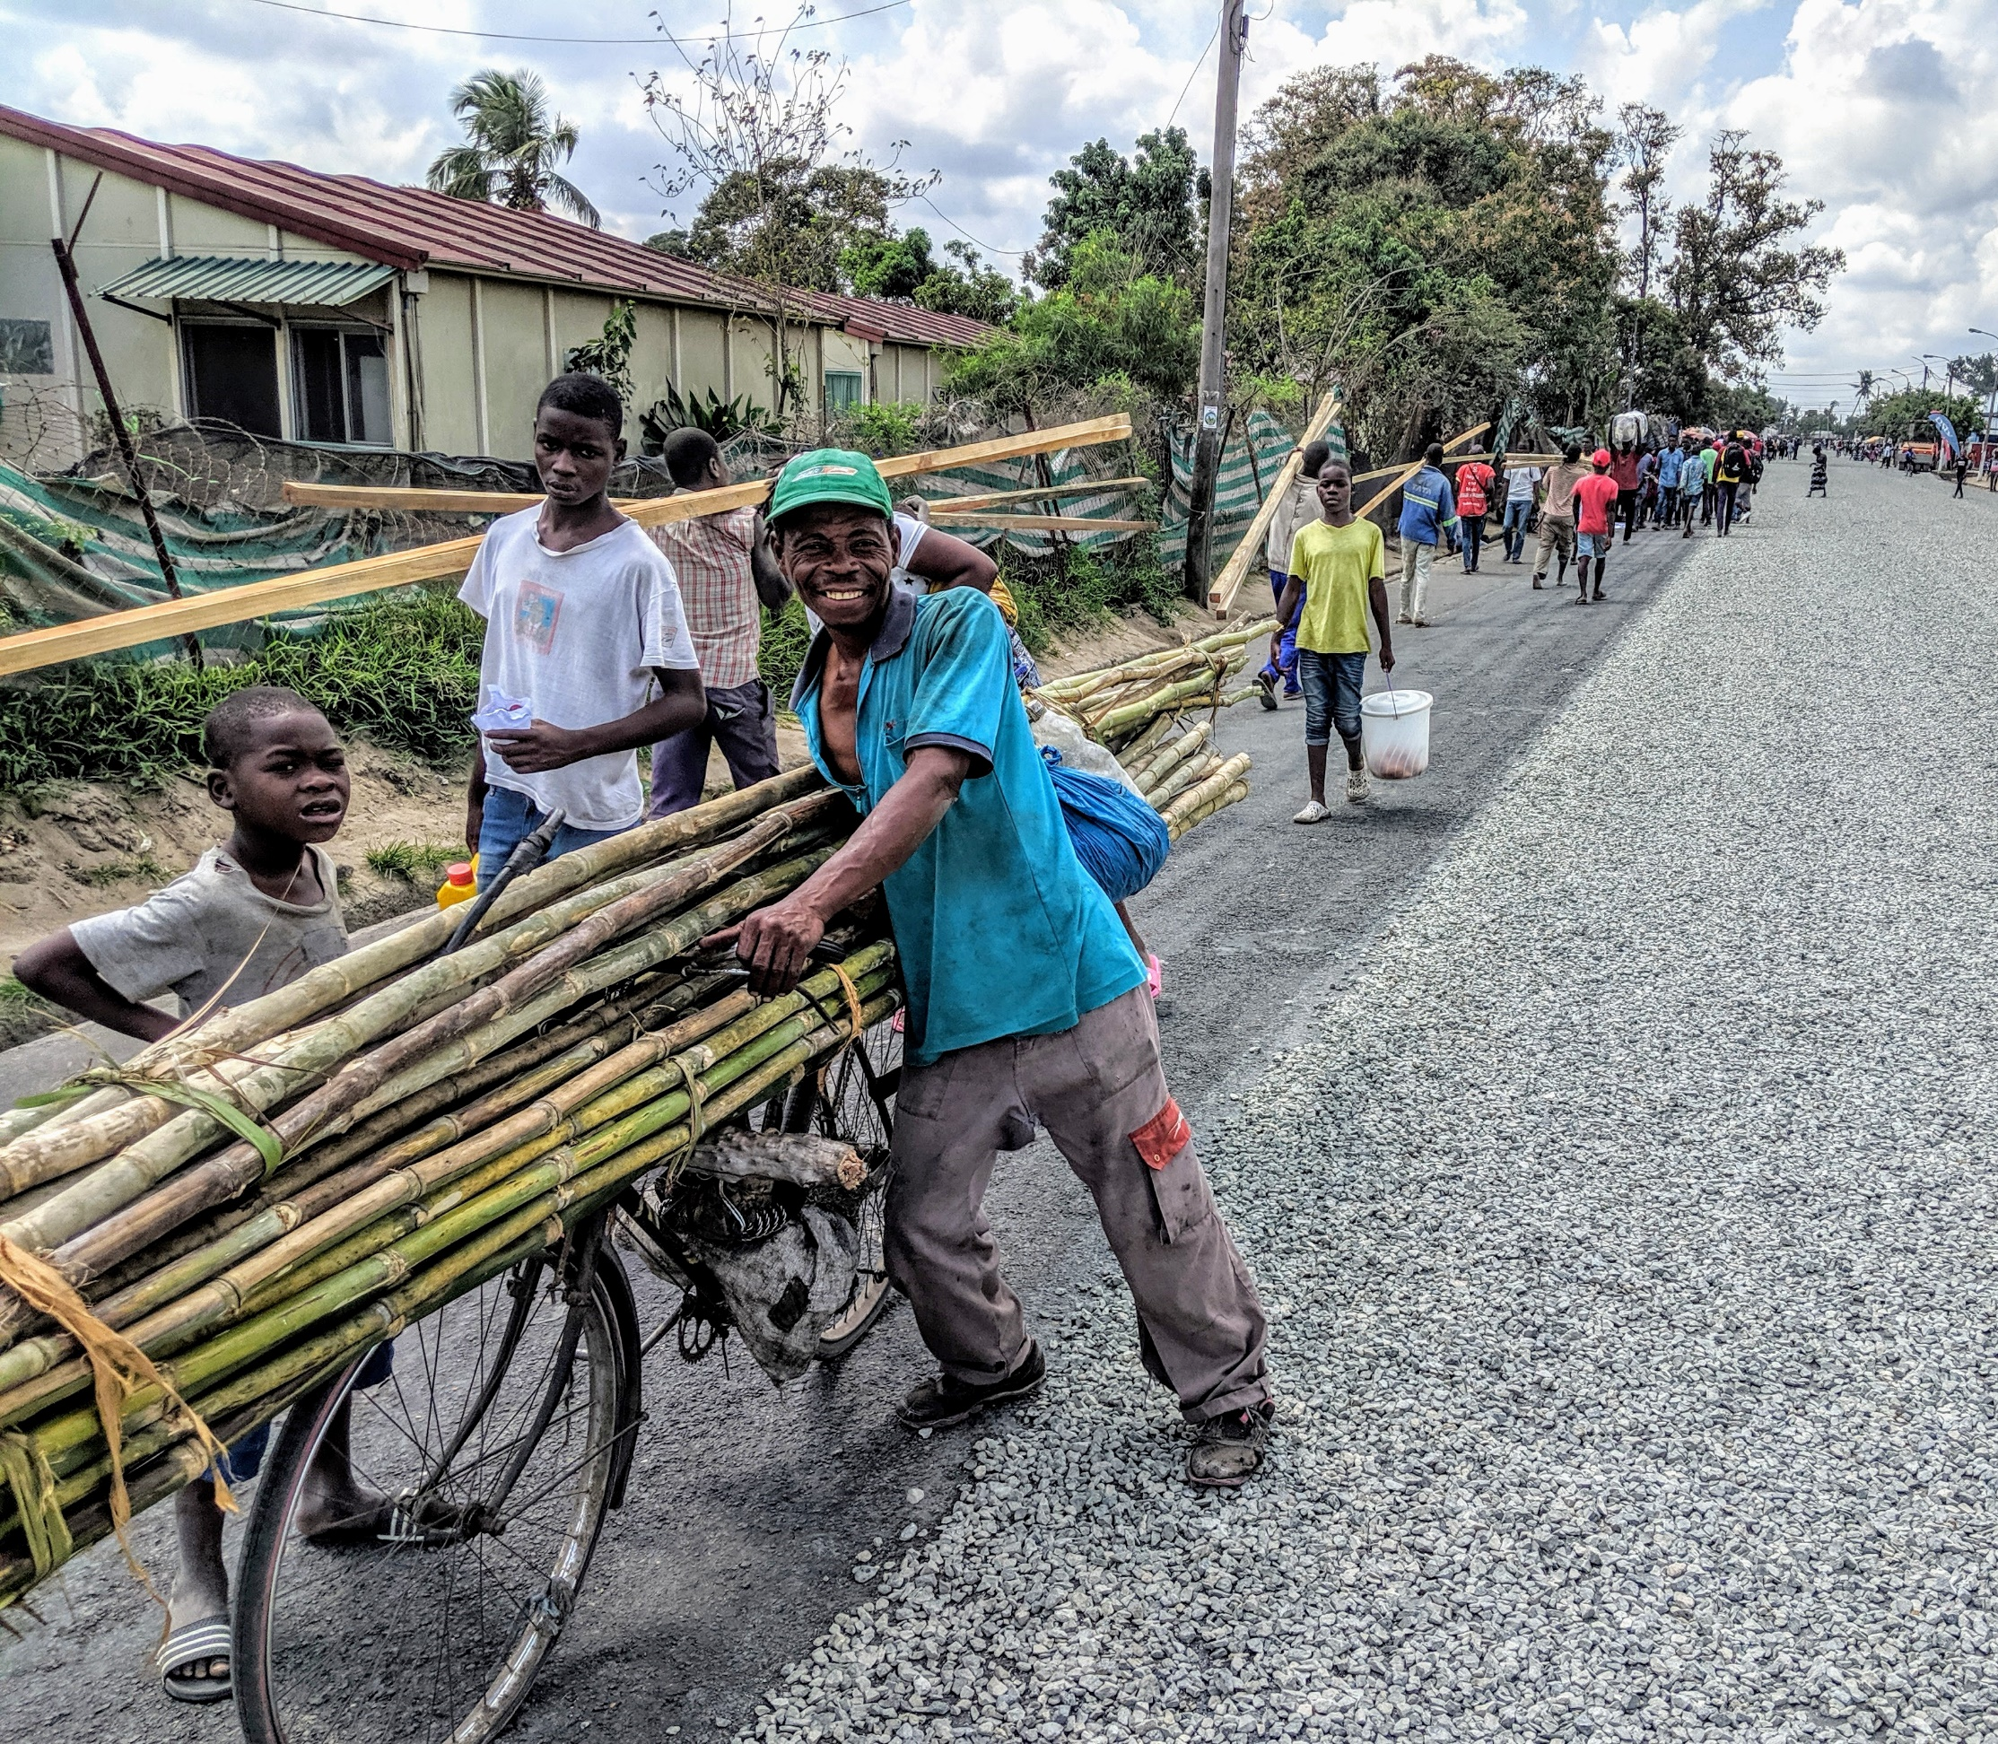
Notes:
Thank you for the opportunity to share a bit about this market assessment
The assessment report and summary documents can be found on the Mozambique shelter cluster site.

