Slide 1
NFI – Issues in the cluster
Shelter cluster Yemen has registered over 160 members, most of them being national, provincial or local.
Non-Food items is representing around 140 000 Households assisted – 700 000 persons-. This figure is still increasing.
Many national & local partners are involved in NFI distribution. Problem of financial support for distribution.
Huge discrepancy in terms of quality and cost – the market is sufficient for items with minimum requirement
Parallel systems are existing with big disparities in term of kit composition and quality:
        a) Shelter Cluster contingency stock
        b) IOM RCT (OCHA) contingency stocks
        c) Small organizations struggling to compose complete kit

Slide 2
NFI – Structural change in the cluster
In 2020, Shelter Cluster introduced a weekly warehouse reconciliation report to monitor all stock level in country. 36 warehouses of the 9 key organizations are participating in reporting items available.
Shelter Cluster presented the intention to shift to a common pipeline in order to ensure items quality, cost efficiency and reinforce clarity of procurement.
With the unexpected flooding, (almost 500 000 individuals affected), Shelter Cluster introduced #72hoursresponse to mobilize contingency stock.

Slide 3

NFI – Common pipeline
Regular distribution related to the conflict
Newly displaced, forecast based on conflict dynamic
Renewal of materials for the shelters of old caseload
Seasonal Distribution(s)
Flood response
Winterization
Summarization
Contingency stock
Static stock
Definition of roles
Repartition of roles.
Estimation of the needs
 | Type of functions | Comments
UN & International Organisations | Cluster Lead Agency Custodian of the common pipeline Large oversea procurement Large national procurement (if necessary) Central warehousing Upstream Logistic (preferred) Downstream Logistic (last resort) | 1 agency in charge at the national level
International NGO | Sub-National Coordination Large and medium local procurement Central & provincial warehousing Contingency stock warehousing Downstream Logistic (preferred) | 1 agency in charge per large area of intervention (north, south, east)
National NGO | Local warehousing Standardized assessment Local Dispatching /Distribution Monitoring &Reporting | Multiple agencies
Community-Based Organisation | Standardized assessment (under supervision) Distribution only | Multiple agencies

Slide 4
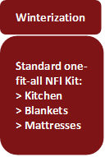
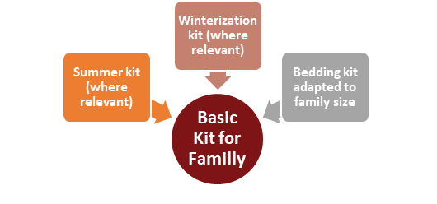
NFI - Technical Working Group - Updates
Why We need the revision ?
A one-fit-all model Basic kit with options according to situation
Flexibility- having option on adopting according to needs, geographical location, or family composition
Cost Saving - for only providing the necessary items only.

Slide 5
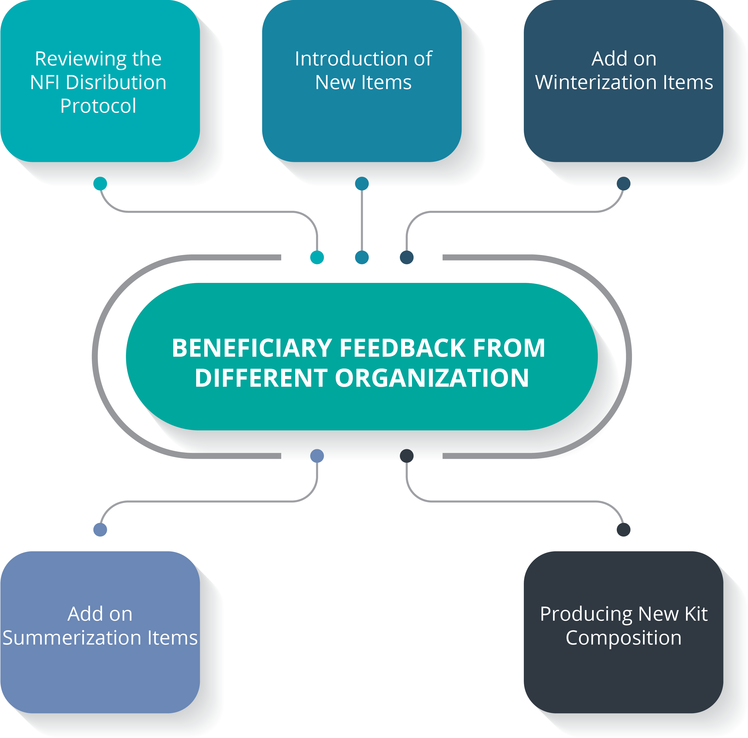
Strategy of kit compositions
Strategy Criteria for reviewing NFIs:
Standard NF Kit Composition-
1)Kitchen Set 2) Mattresses 3) Blankets 4) Bucket 5)Sleeping mat

Slide 6
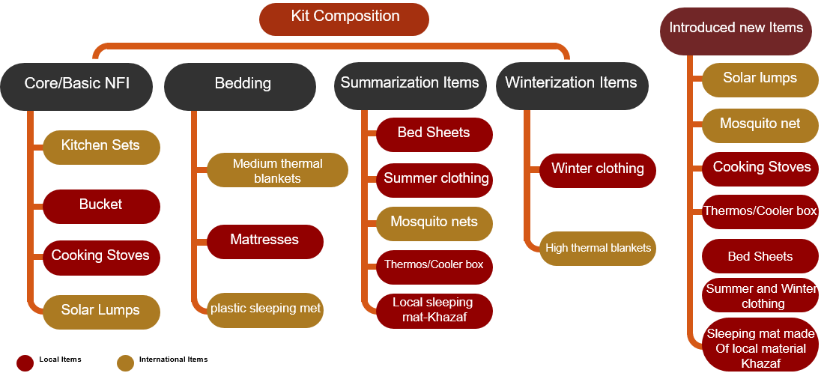
Strategy of kit compositions- Procurement status
New NFI Kit Composition:
    Summary :
    Current NFI Budget = 177$ New NFI Budget = 385.3$
    Current NFI Kit has 5 Items The new NFI kit has 13 items
    Revised NFIs- We have 7 Items to be locally procured and 6 Items to be Internationally Procured
Solar Lamps
Solar Lamps

Slide 7
NFI-TWiG Highlights
Main Publications by the NFI TWiG
New NFI kit Composition, Specifications, price and quantities
NFI Market assessment form
NFI TWiG meeting minutes
Revised NFI PDM guideline
NFI Technical report
Constraints :
Virtual TWiG meetings due to Covid-19
Distributions during the pandemic period
TWiG discussions:
NFI TWiG members
National and Sub National Cluster coordinators
Ad-hoc meetings with the Shelter/NFI Partners
Local Authority discussions on the findings
Presenting the outcomes of the meetings to the SAG members

