Slide 1
VENEZUELA
SHELTER, ENERGY AND NFI CLUSTER
Fuel discussion Global Shelter Cluster NFI WG
Field experience
6 August 2020
Shelter Cluster Coordinator: Adriana Durán
Assoc Information Management Officer: Luis Alcaraz Pardo
Assistant: Emigdio Filardi

Slide 2
Content
Venezuela situation
Pilot project: an alternative energy source for cooking (biodigester)
Response: improved access to energy/electricity and NFIs
Lessons learned and challenges

Slide 3
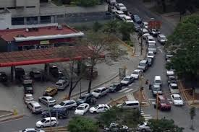
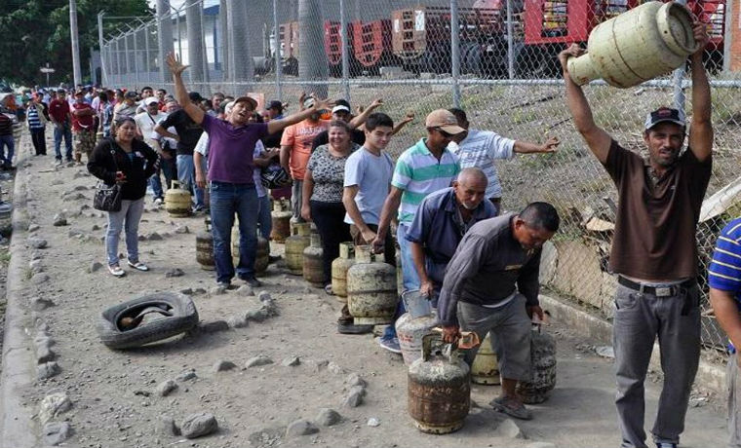
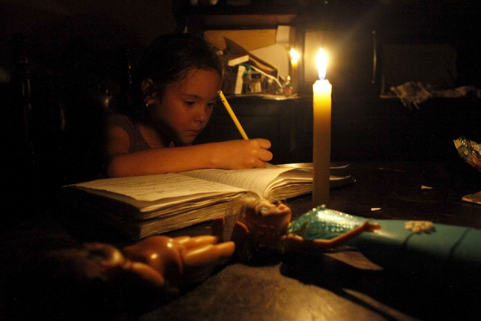
1. Context and needs: access to energy/electricity
Fuel access restrictions
Limited access to gas bottles
1
2
Limited access to electricity
1.https://www.el-carabobeno.com/preven-que-escasez-de-gasolina-en-venezuela-se-agravara-en-proximas-semanas/
2. https://www.caraotadigital.net/hoy/93-de-la-poblacion-venezolana-depende-las-bombonas-de-gas
3. https://www.elpais.com.uy/mundo/saqueos-protestas-cortes-luz-venezuela.html Photo: Reuters
3

Slide 4
Estimated population with shelter, energy and NFI needs (HPC 2020)
% of HHs living in sub-standard and overcrowded shelters
EHM (INE), S2 2018
% HHs with sub-standard bathroom facilities
VAM (WFP), 2019
% HHs reporting use of unsafe alternative sources of gas for cooking
VAM (WFP), 2019
% of HHs without gas or electric kitchen
EHM (INE), S2 2018
% HHs reporting daily electricity cuts
VAM (WFP), 2019
People in
Need (PiN)
1.38 M

Slide 5

Estimated population with shelter, energy and NFI needs (HPC 2020)
State
Severity
# projects
3
3
5
6
7
3
Bolívar | 4 | 7
Miranda | 3 | 7
Zulia | 4 | 6
Distrito Capital | 3 | 5
Anzoátegui | 3 | 4
Merida | 1 | 4
Táchira | 4 | 4
Apure | 4 | 3
Carabobo | 3 | 3
Falcón | 3 | 3
Nueva Esparta | 2 | 3
Sucre | 4 | 3
Amazonas | 4 | 2
Delta Amacuro | 4 | 2
Guárico | 3 | 2
Lara | 2 | 2
Vargas | 2 | 2
Yaracuy | 2 | 2
Monagas | 3 | 1
Portuguesa | 2 | 1
Aragua | 1 | 0
Barinas | 2 | 0
Cojedes | 2 | 0
Trujillo | 2 | 0
2
3
2
4
1
1
2
2
4
4
3
7
Distrito Capital
1 - mínimo
2 - estrés
3 - severo
2
4 - crítico
5 - catastrófico
# de proyectos con alcance en este estado

Slide 6
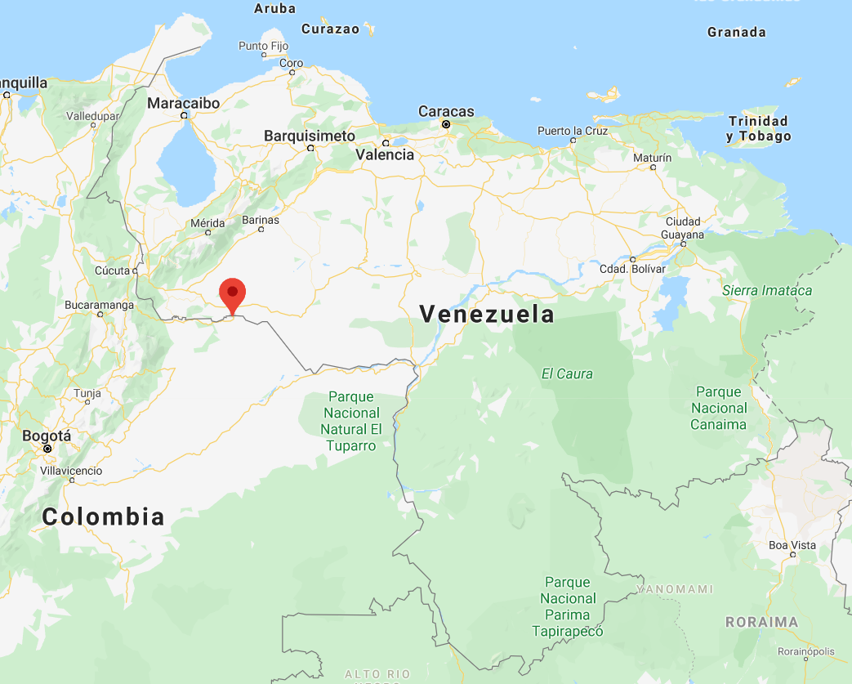
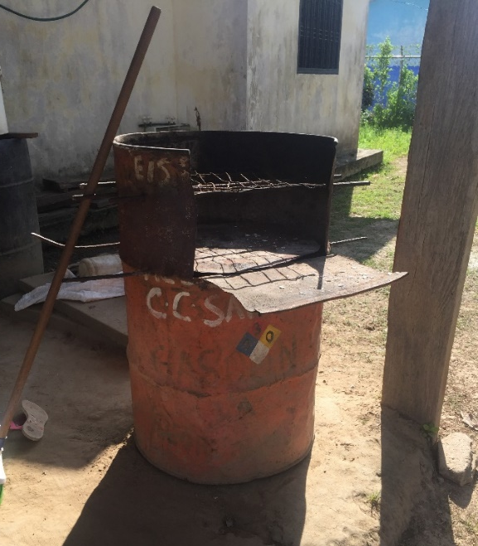
2. Pilot project alternative for energy source for cooking – Biodigester (I)
Guamalito is an indigenous community settled in Apure state, on the banks of the Arauca River, bordering Colombia.
In this community there is a lack of domestic gas for cooking.
Increased use of firewood for cooking.
The use of firewood has an impact in respiratory health.
The installation of a biodigester was proposed as a pilot project in this community.

Slide 7
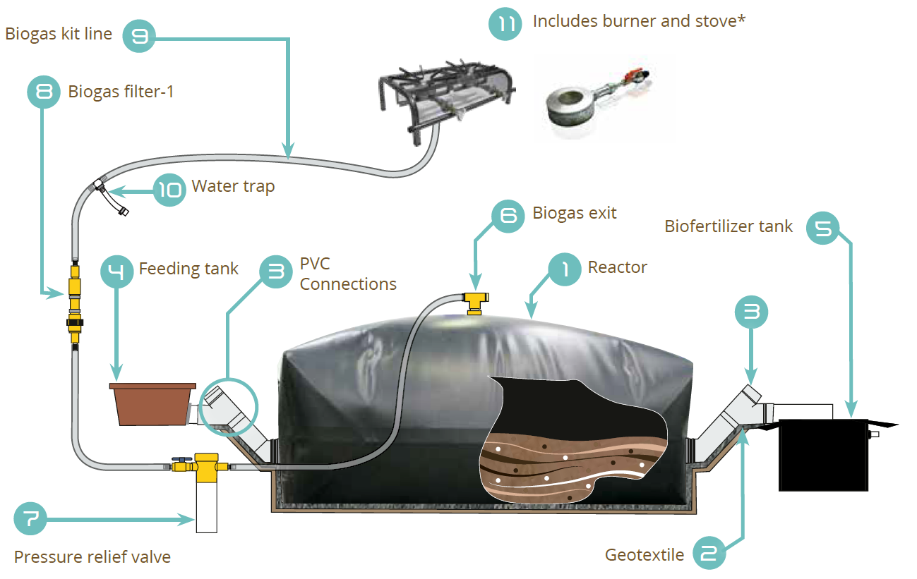
2. Pilot Project alternative for energy source for cooking – Biodigester (II)
Is a hermetic reactor that receives the daily waste of a farm or community, in which the compost is fermented.
This mixture produces biogas which goes through pipes to points of use.
Biogas is a energy source for cooking.
Figure 1. Components of a biogester. Source: Sistema.bio

Slide 8
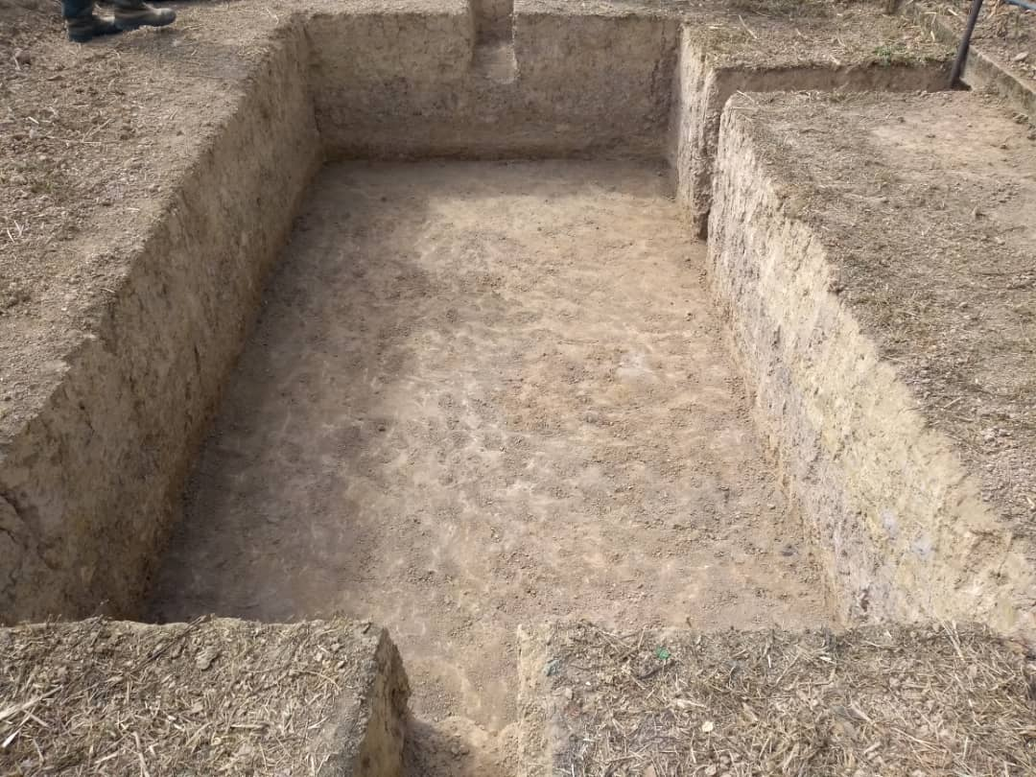
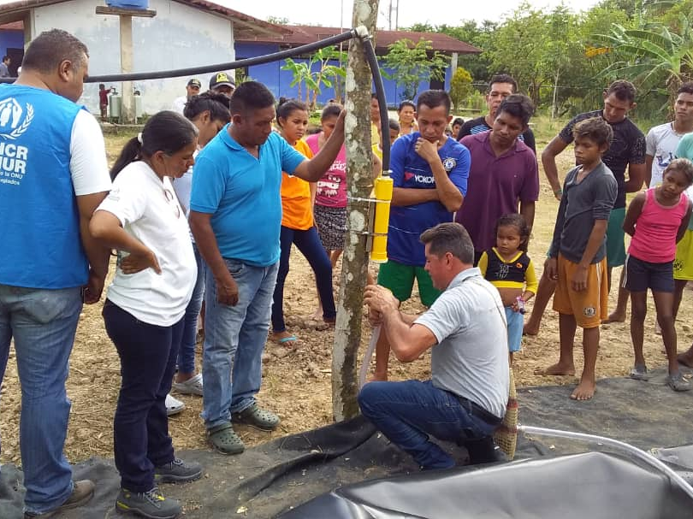
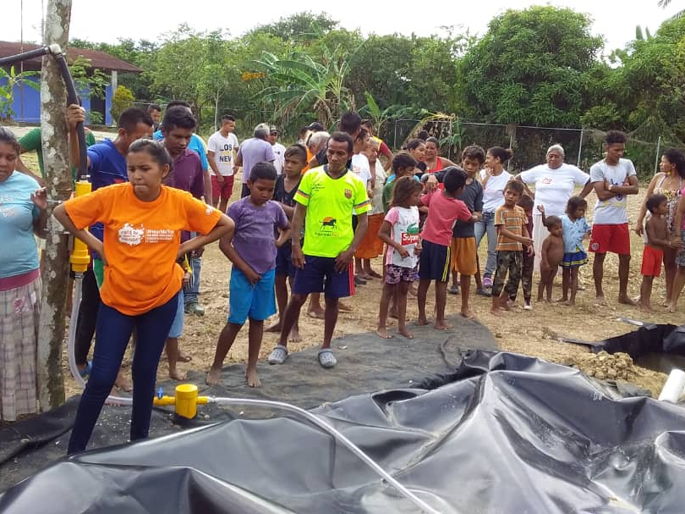
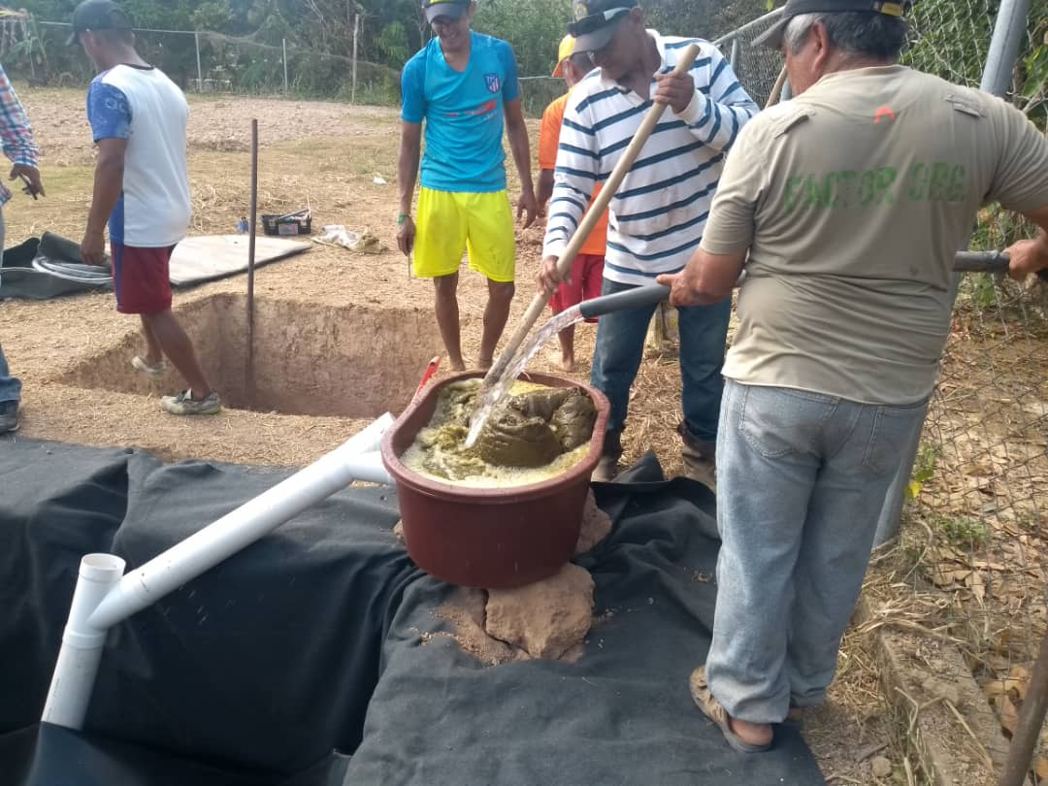
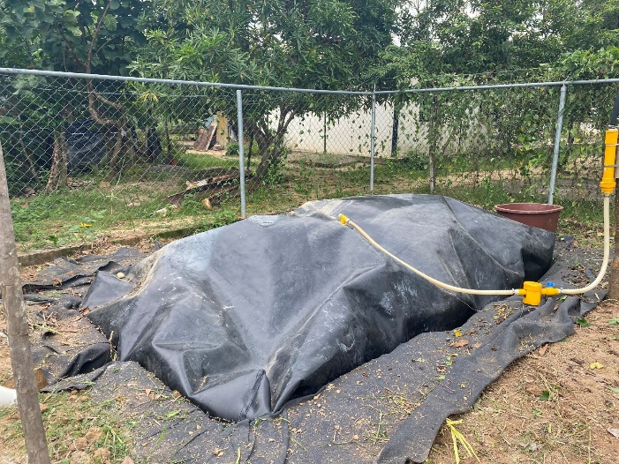
Guamalito community
2. Pilot Project alternative for energy source for cooking – Biodigester (III)
BIODIGESTER COST (PILOT PROJECT)
Biodigester and Installation (3 visits: diagnostic - installation - monitoring) | $ 1,670 USD
Importation from Colombia: (transport, cost of air travel) | $ 3,000 USD
TOTAL | $ 4,670 USD
Source: UNHCR, 2019

Slide 9
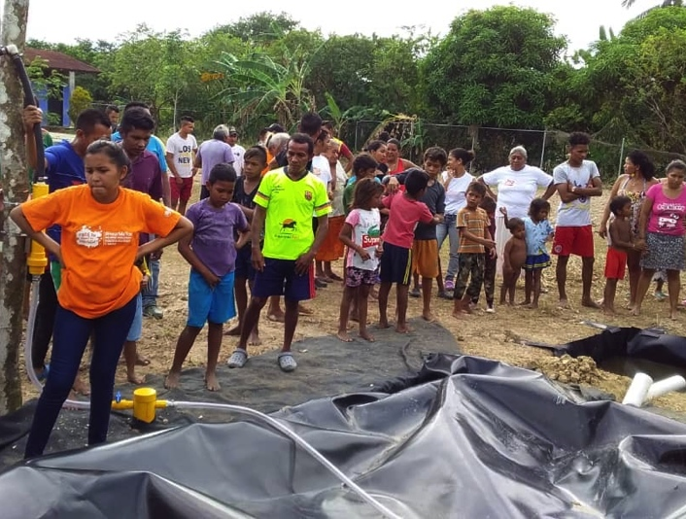
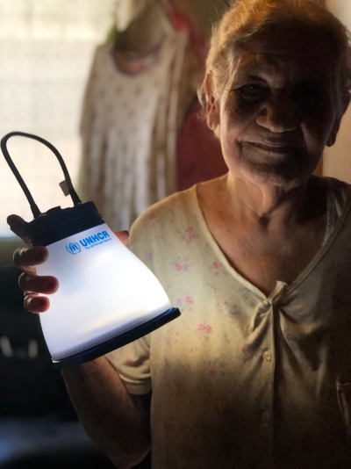
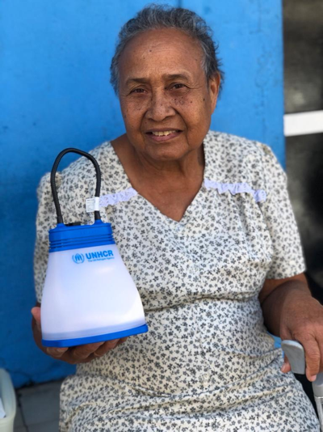
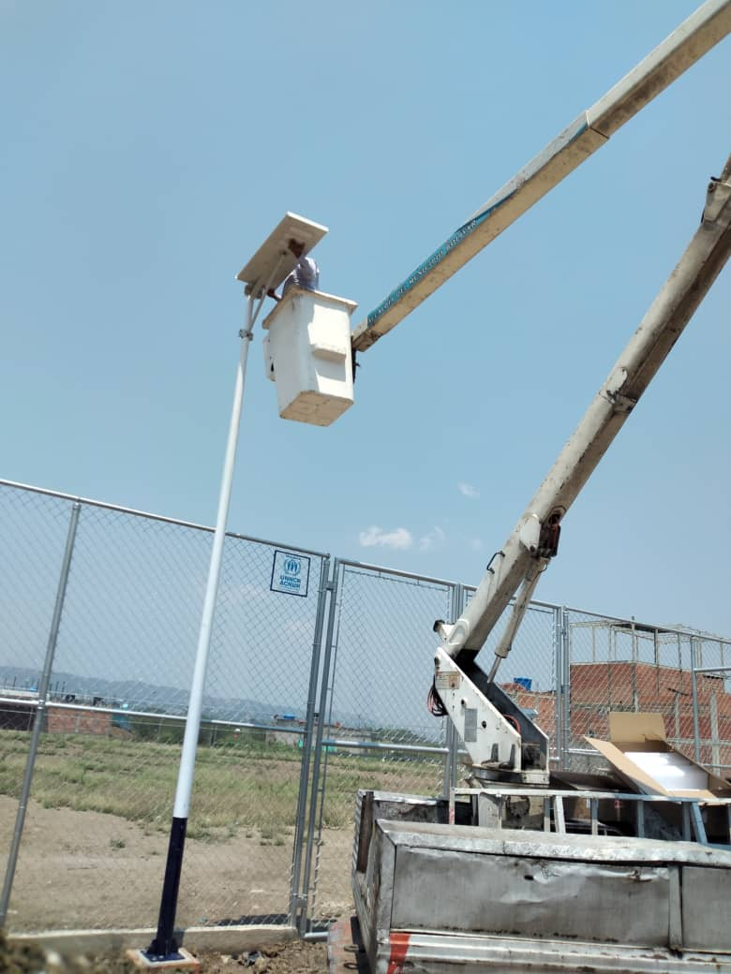
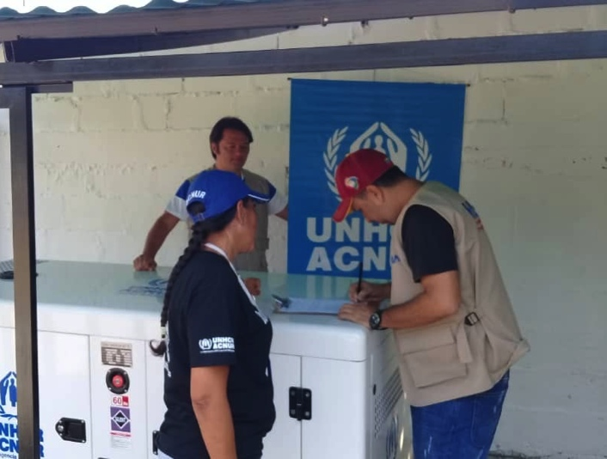
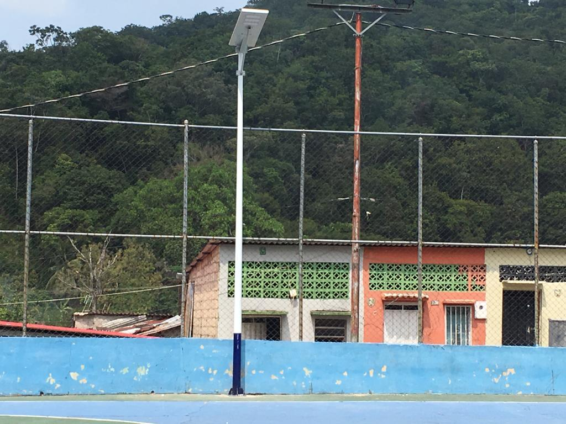
3. Examples of response (I): Equipment and improved access to energy/electricity

Slide 10
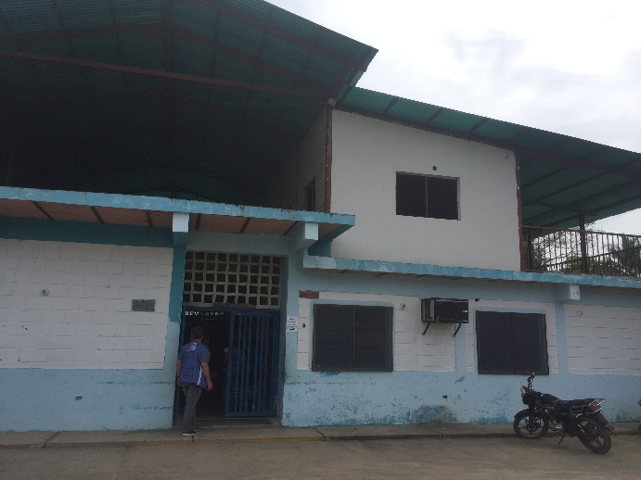
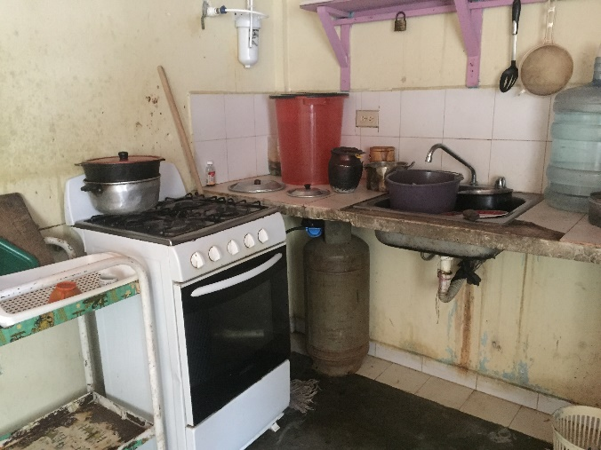
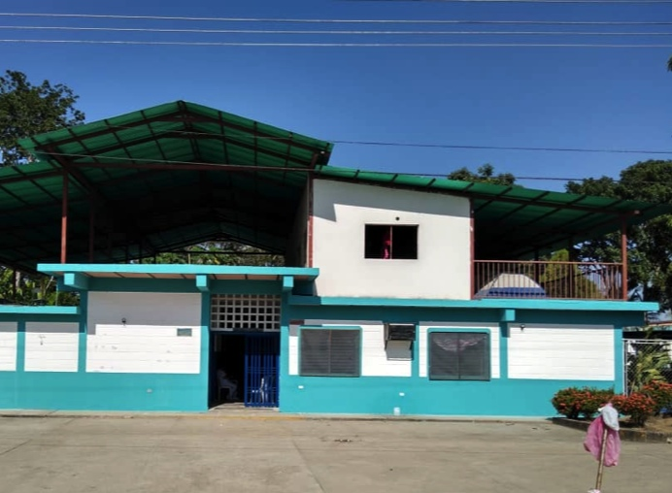
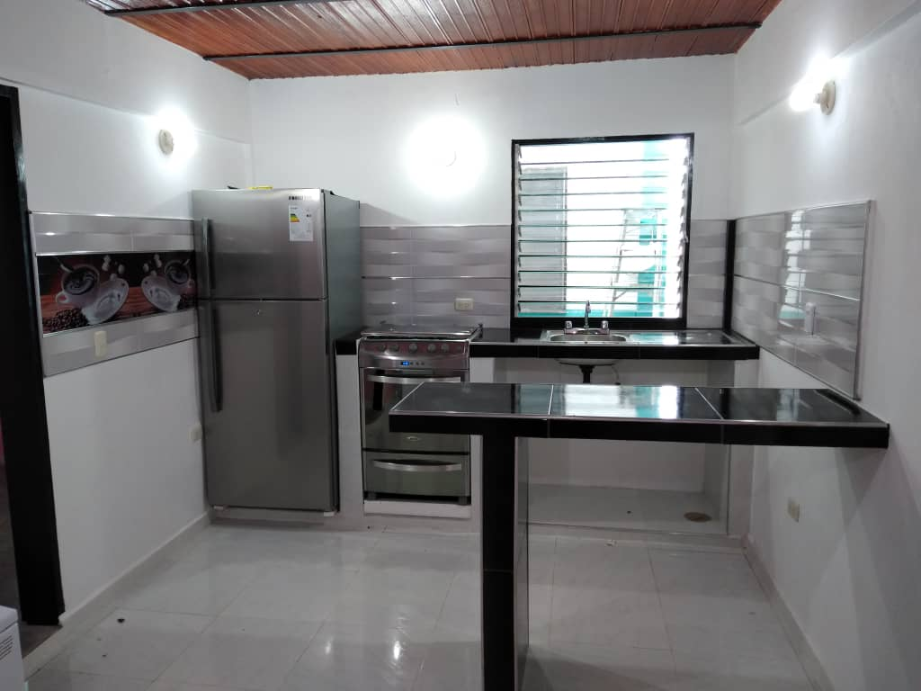
3. Examples of response (I): Equipment and improved access to energy/electricity

Slide 11
4. Challenges
Limited resources for both international and local partners, which limits response capacity. No response in Sucre and Delta Amacuro; very limited in Bolívar and Amazonas.
Energy-related activities represent only 19% of the overall response.
Fuel for cooking: only charcoal distributions in border areas.
Fuel access restrictions, affecting operations of partners, plus higher transportation costs (now 0.5 USD/L; before almost free).
Movement restrictions due to COVID-19 pandemic, affecting operations.
Limited technical and operational capacity of local members.

Slide 12
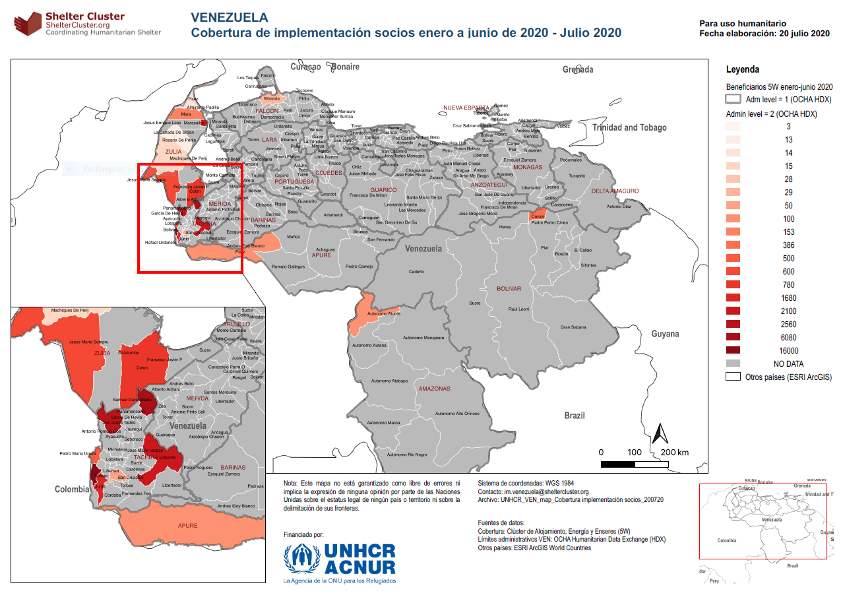

Slide 13
4. Lessons learned
Mainstreaming AAP processes into early stages of the project cycle for all Shelter Cluster partners: do communities need charcoal?
Localising the response and empowerment of local partners to become a sustainable part of the response: who eats the cake? – main partners are UN agencies.
Synergies with other interventions: how to considerably increase partners’ capacity to sustain interventions over the years?: what if funding for energy interventions is not available?

